Slide 1
Control Board Relay-Thermostat Cable Manufacturing Instructions

Slide 2
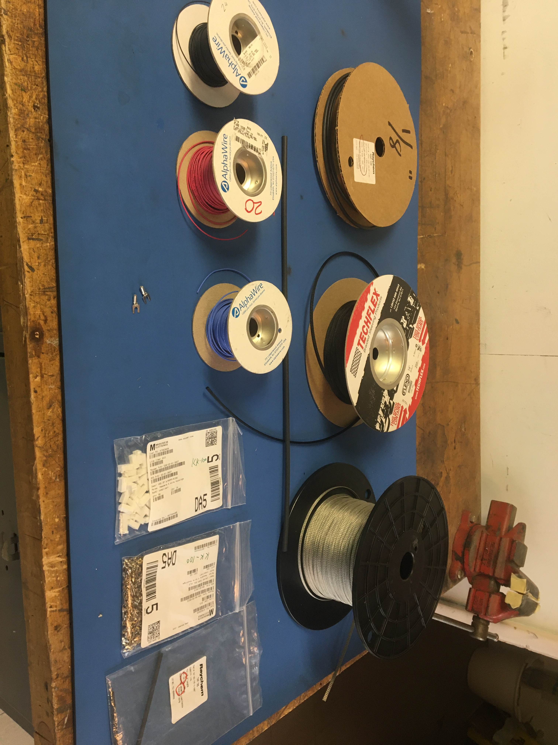
Materials

Slide 3
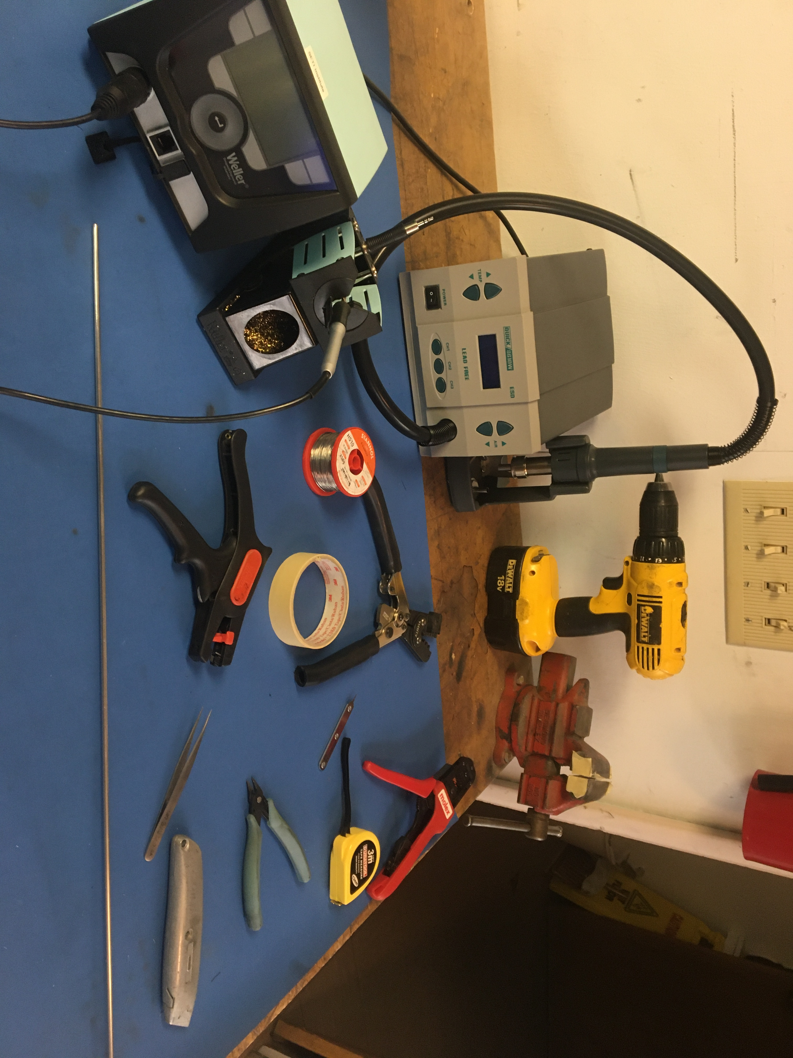
Tools

Slide 4
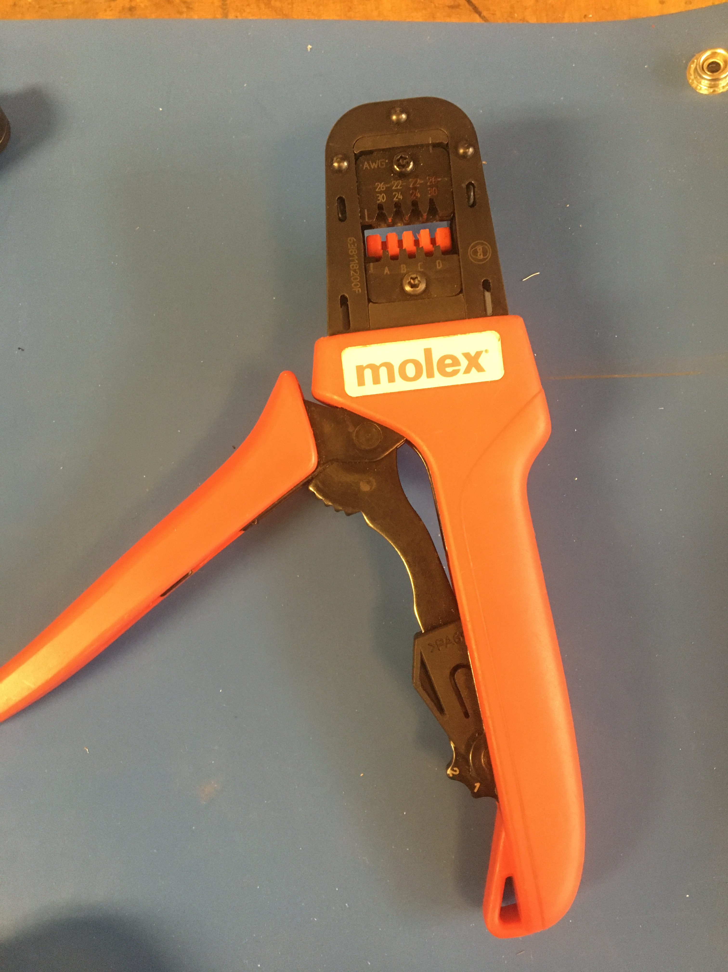
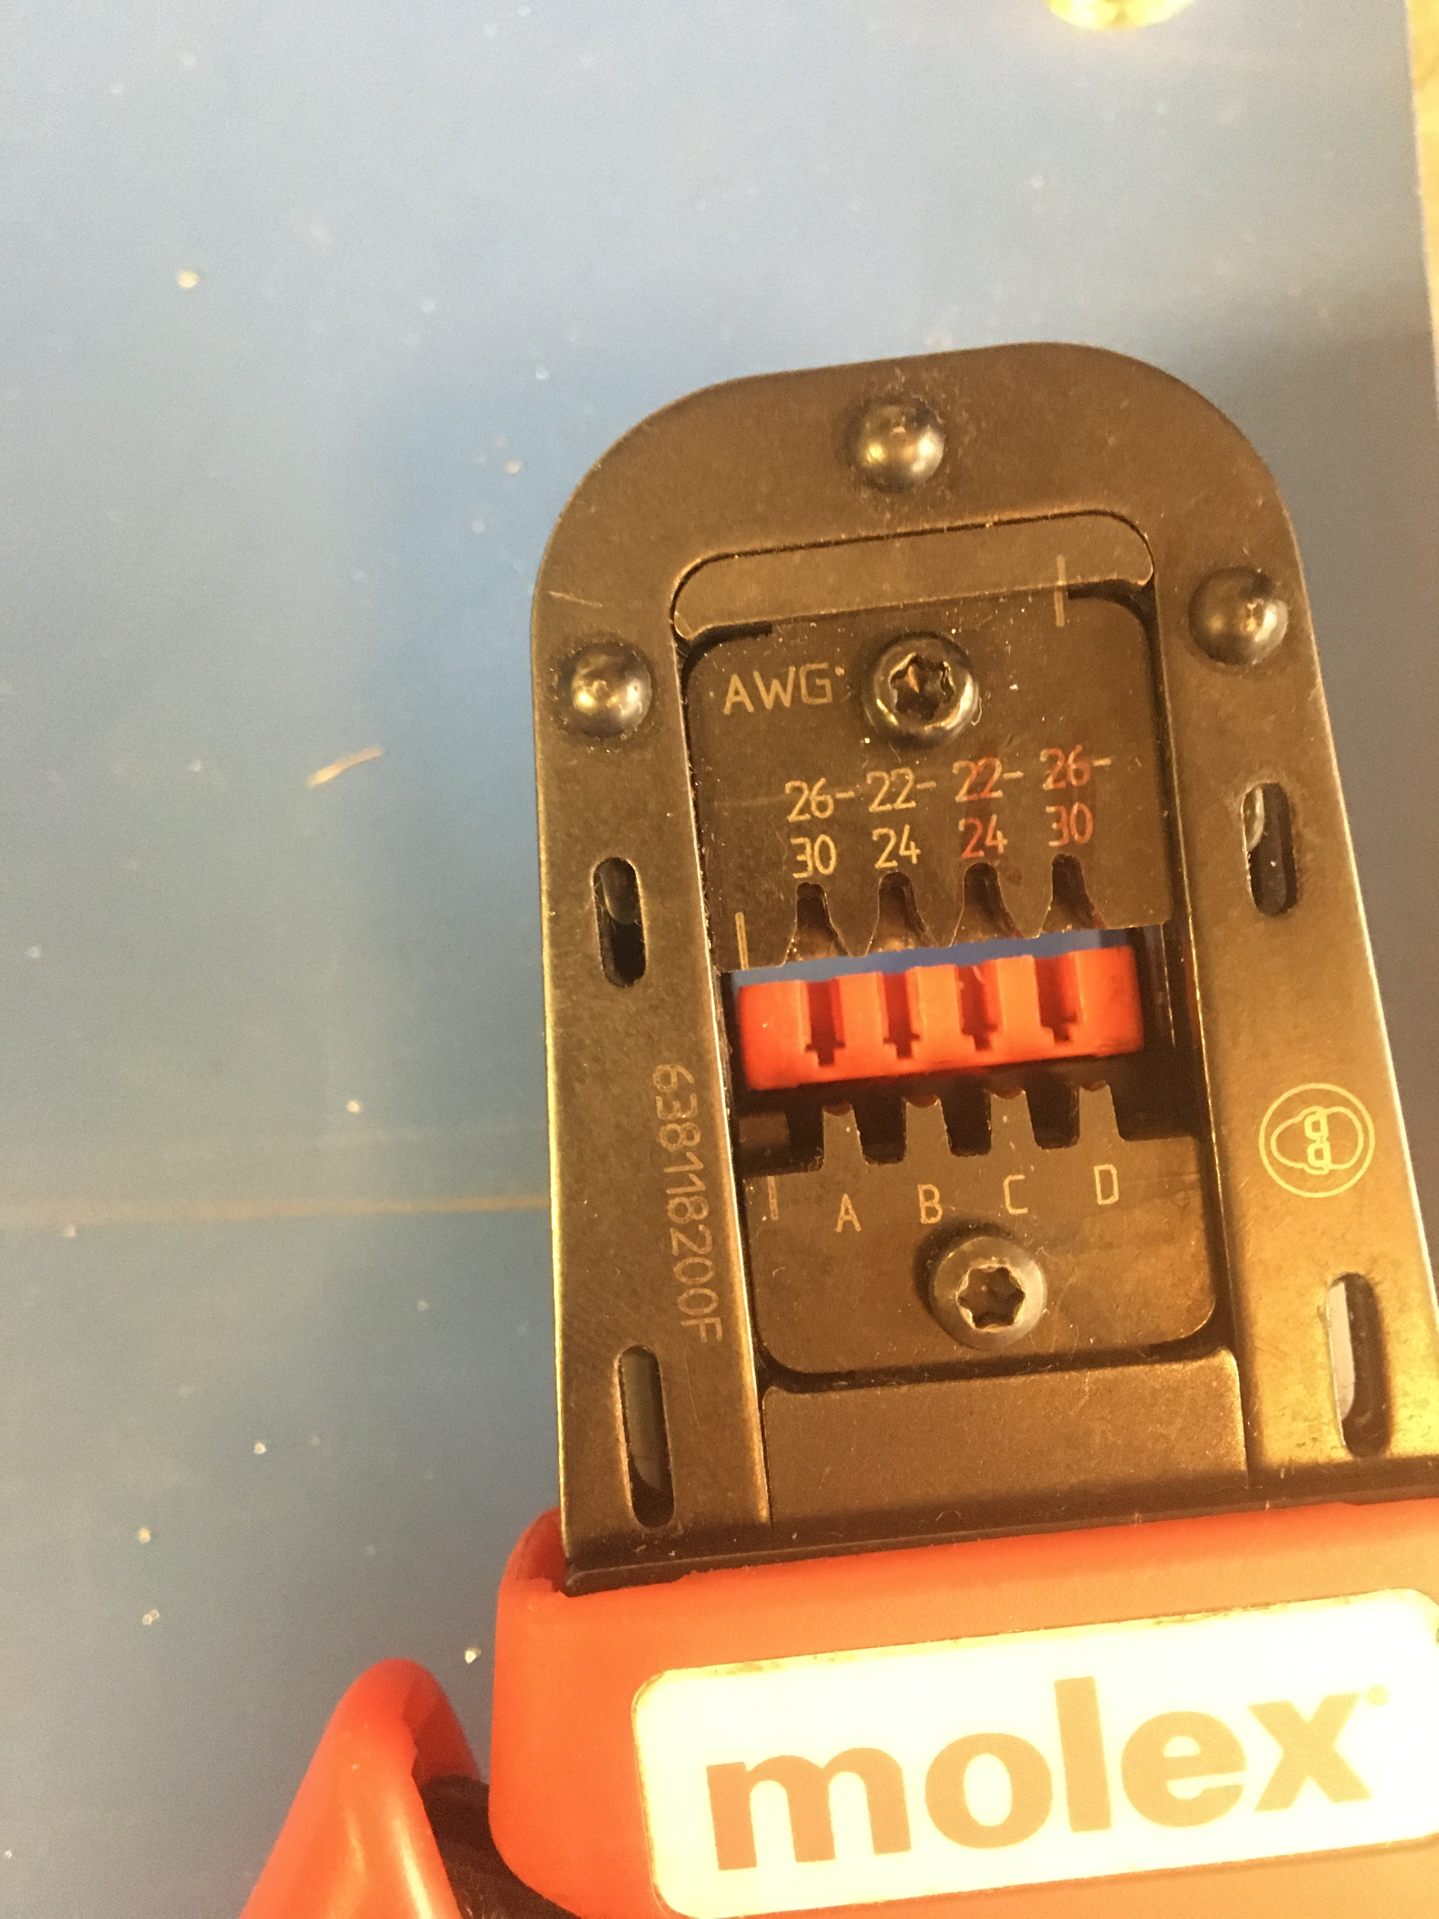
KK 254 Crimper

Slide 5
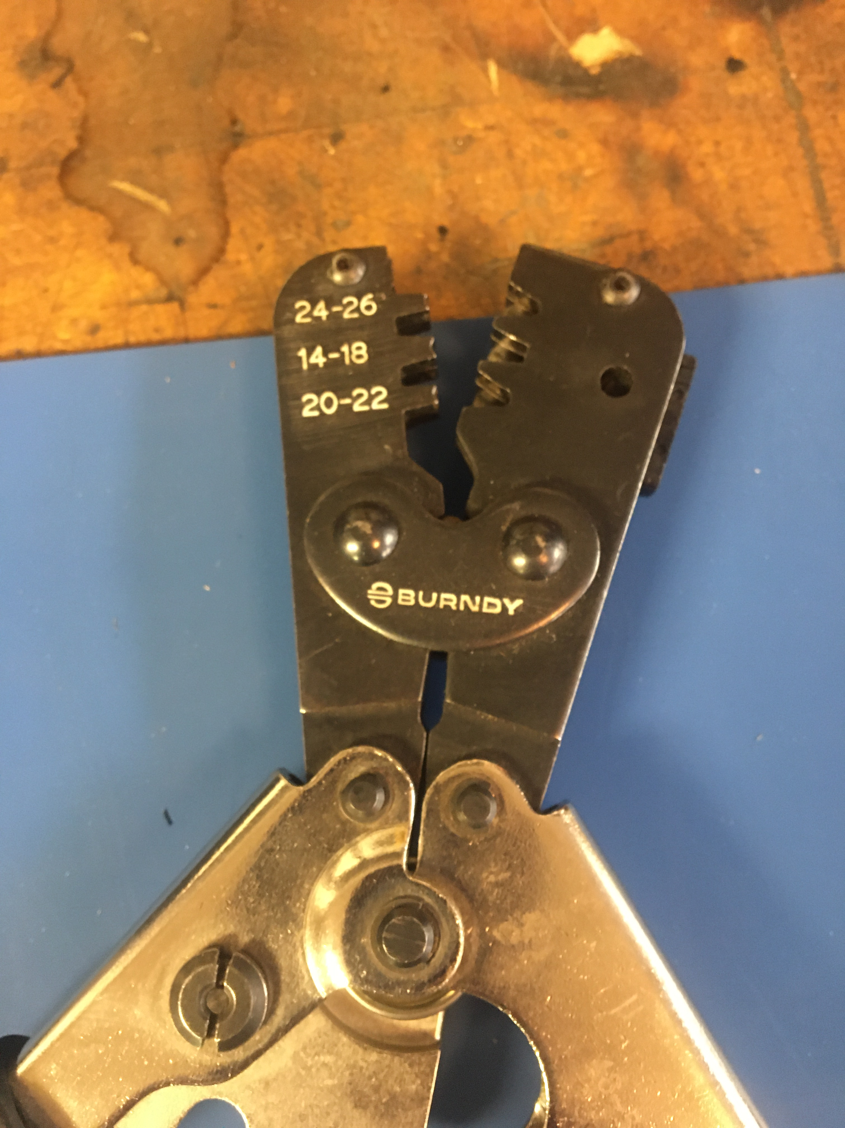
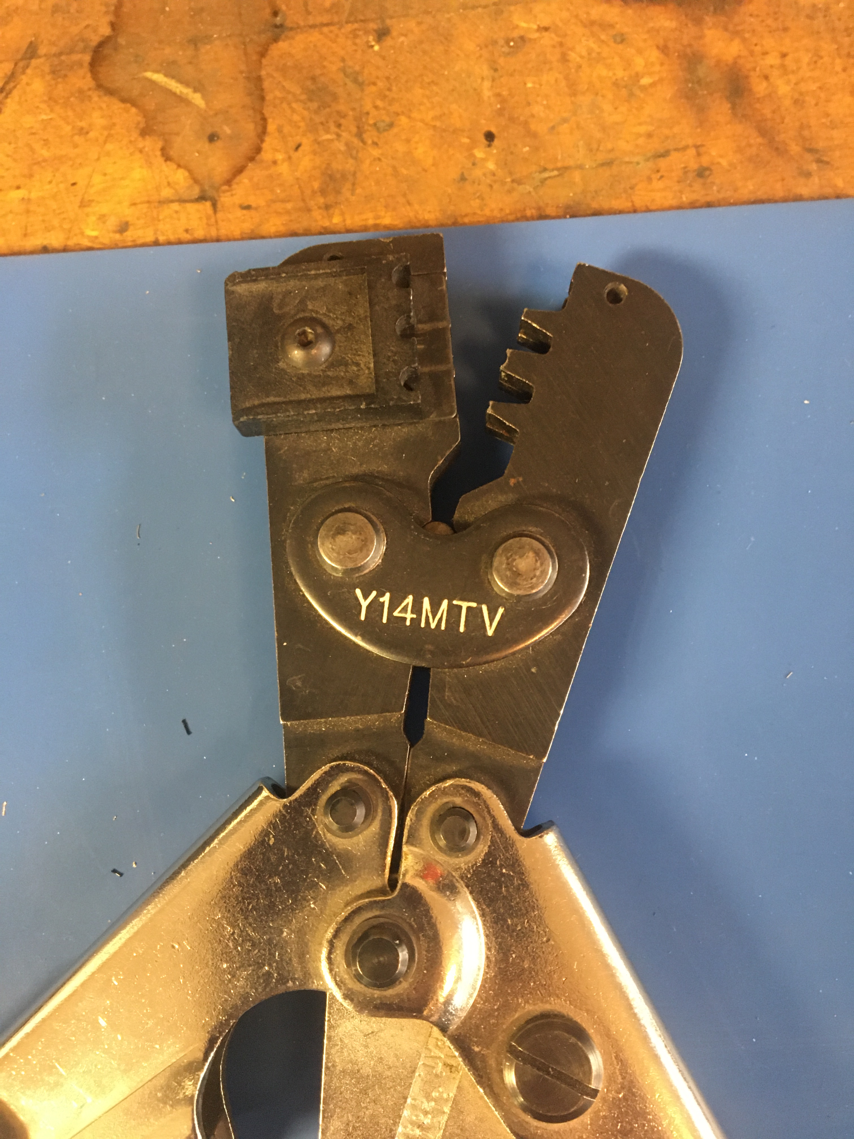
Fork Crimper

Slide 6
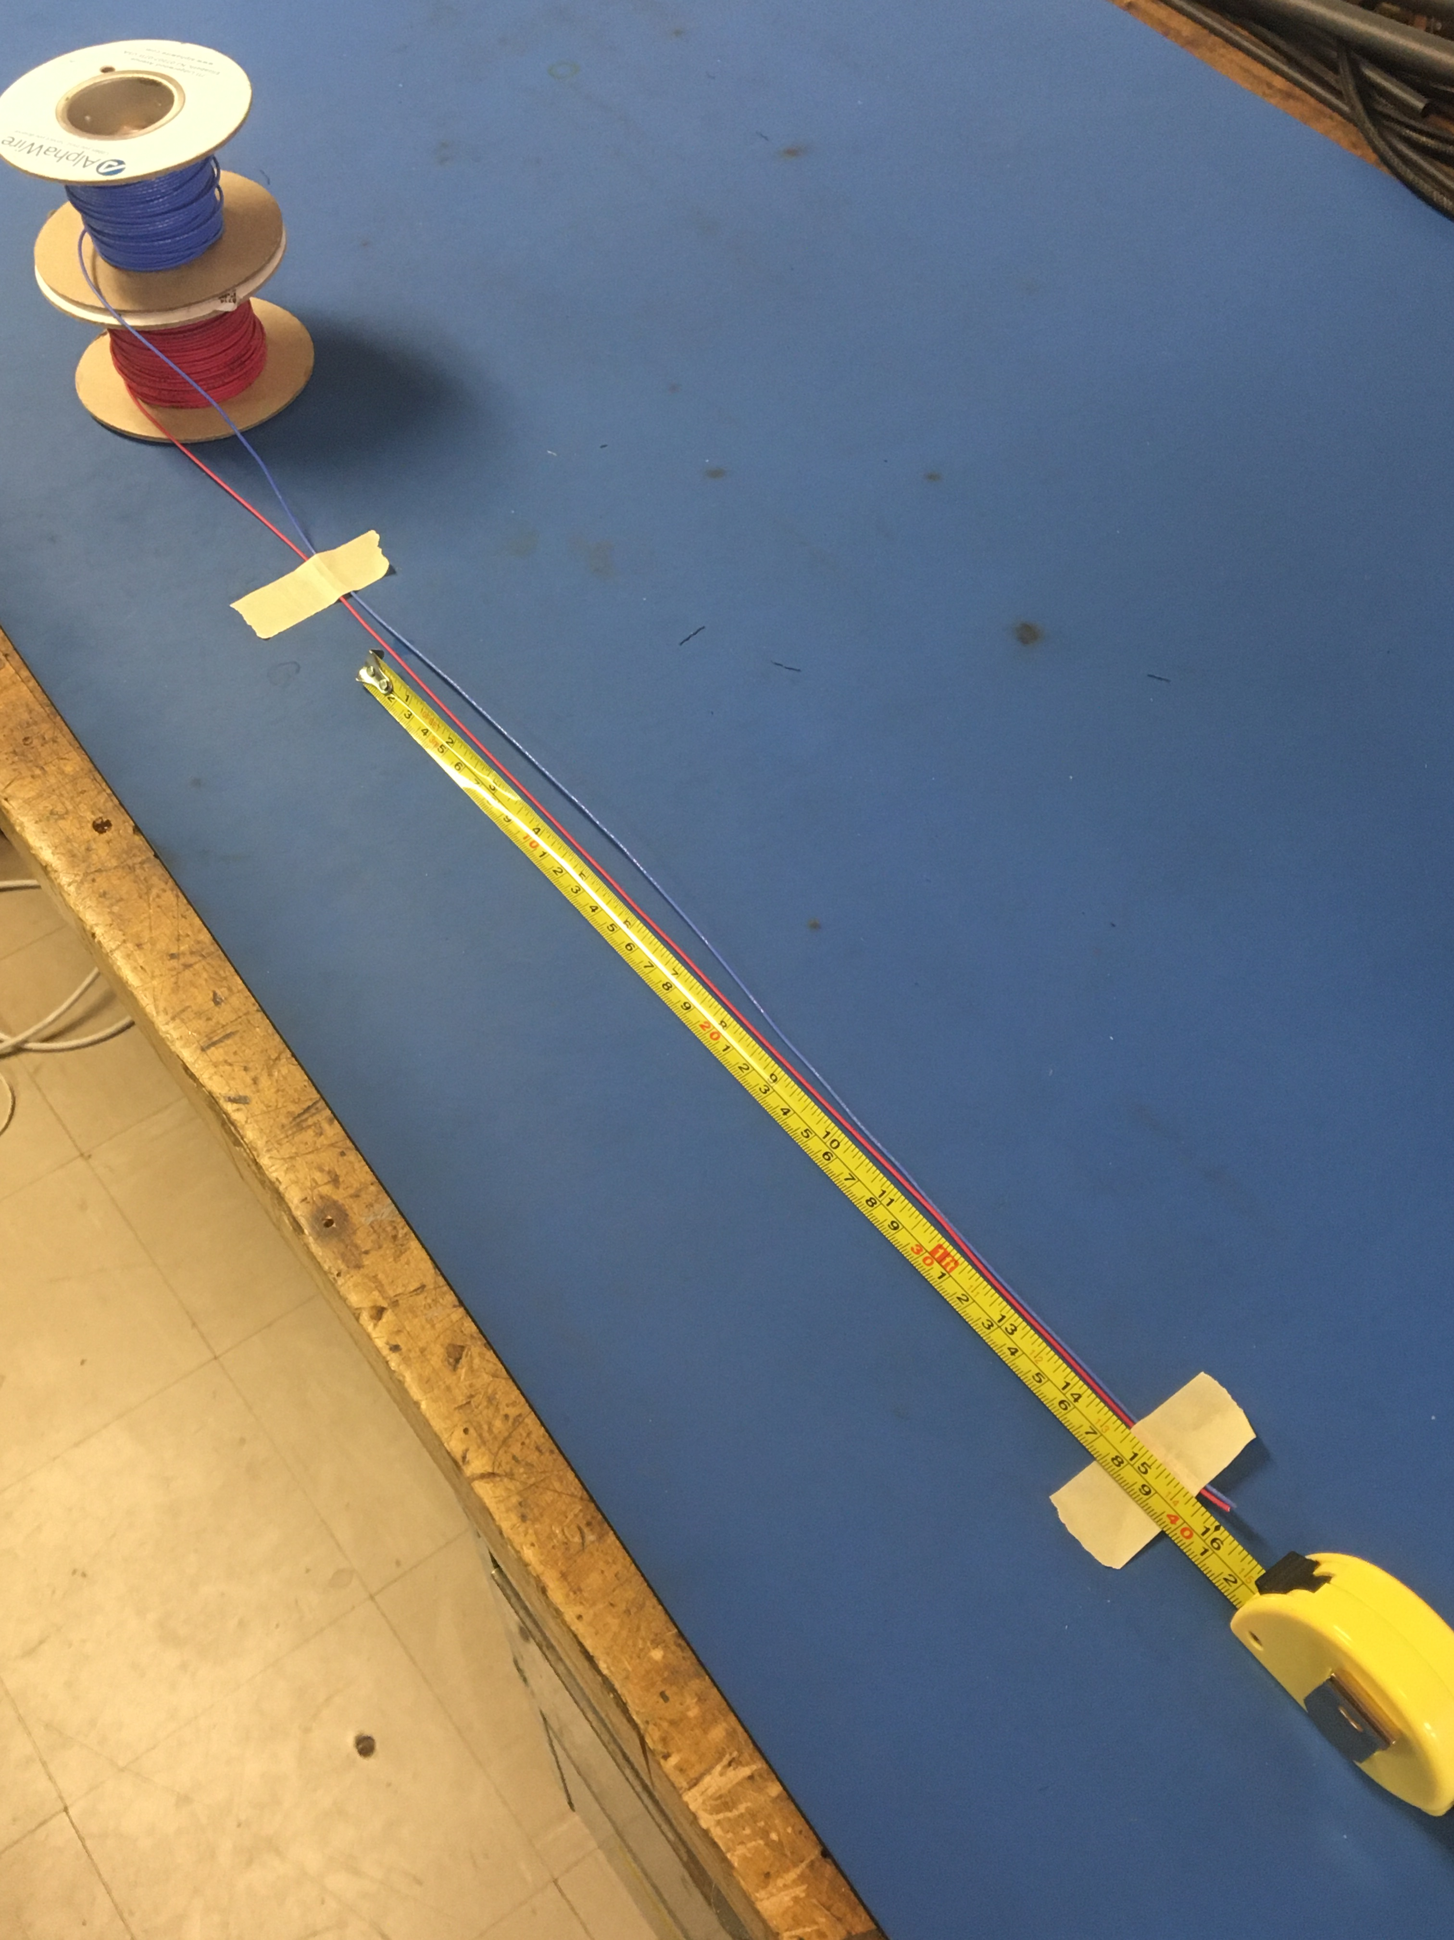
Measure out and cut 16 inches of the blue and red 20 awg wire

Slide 7
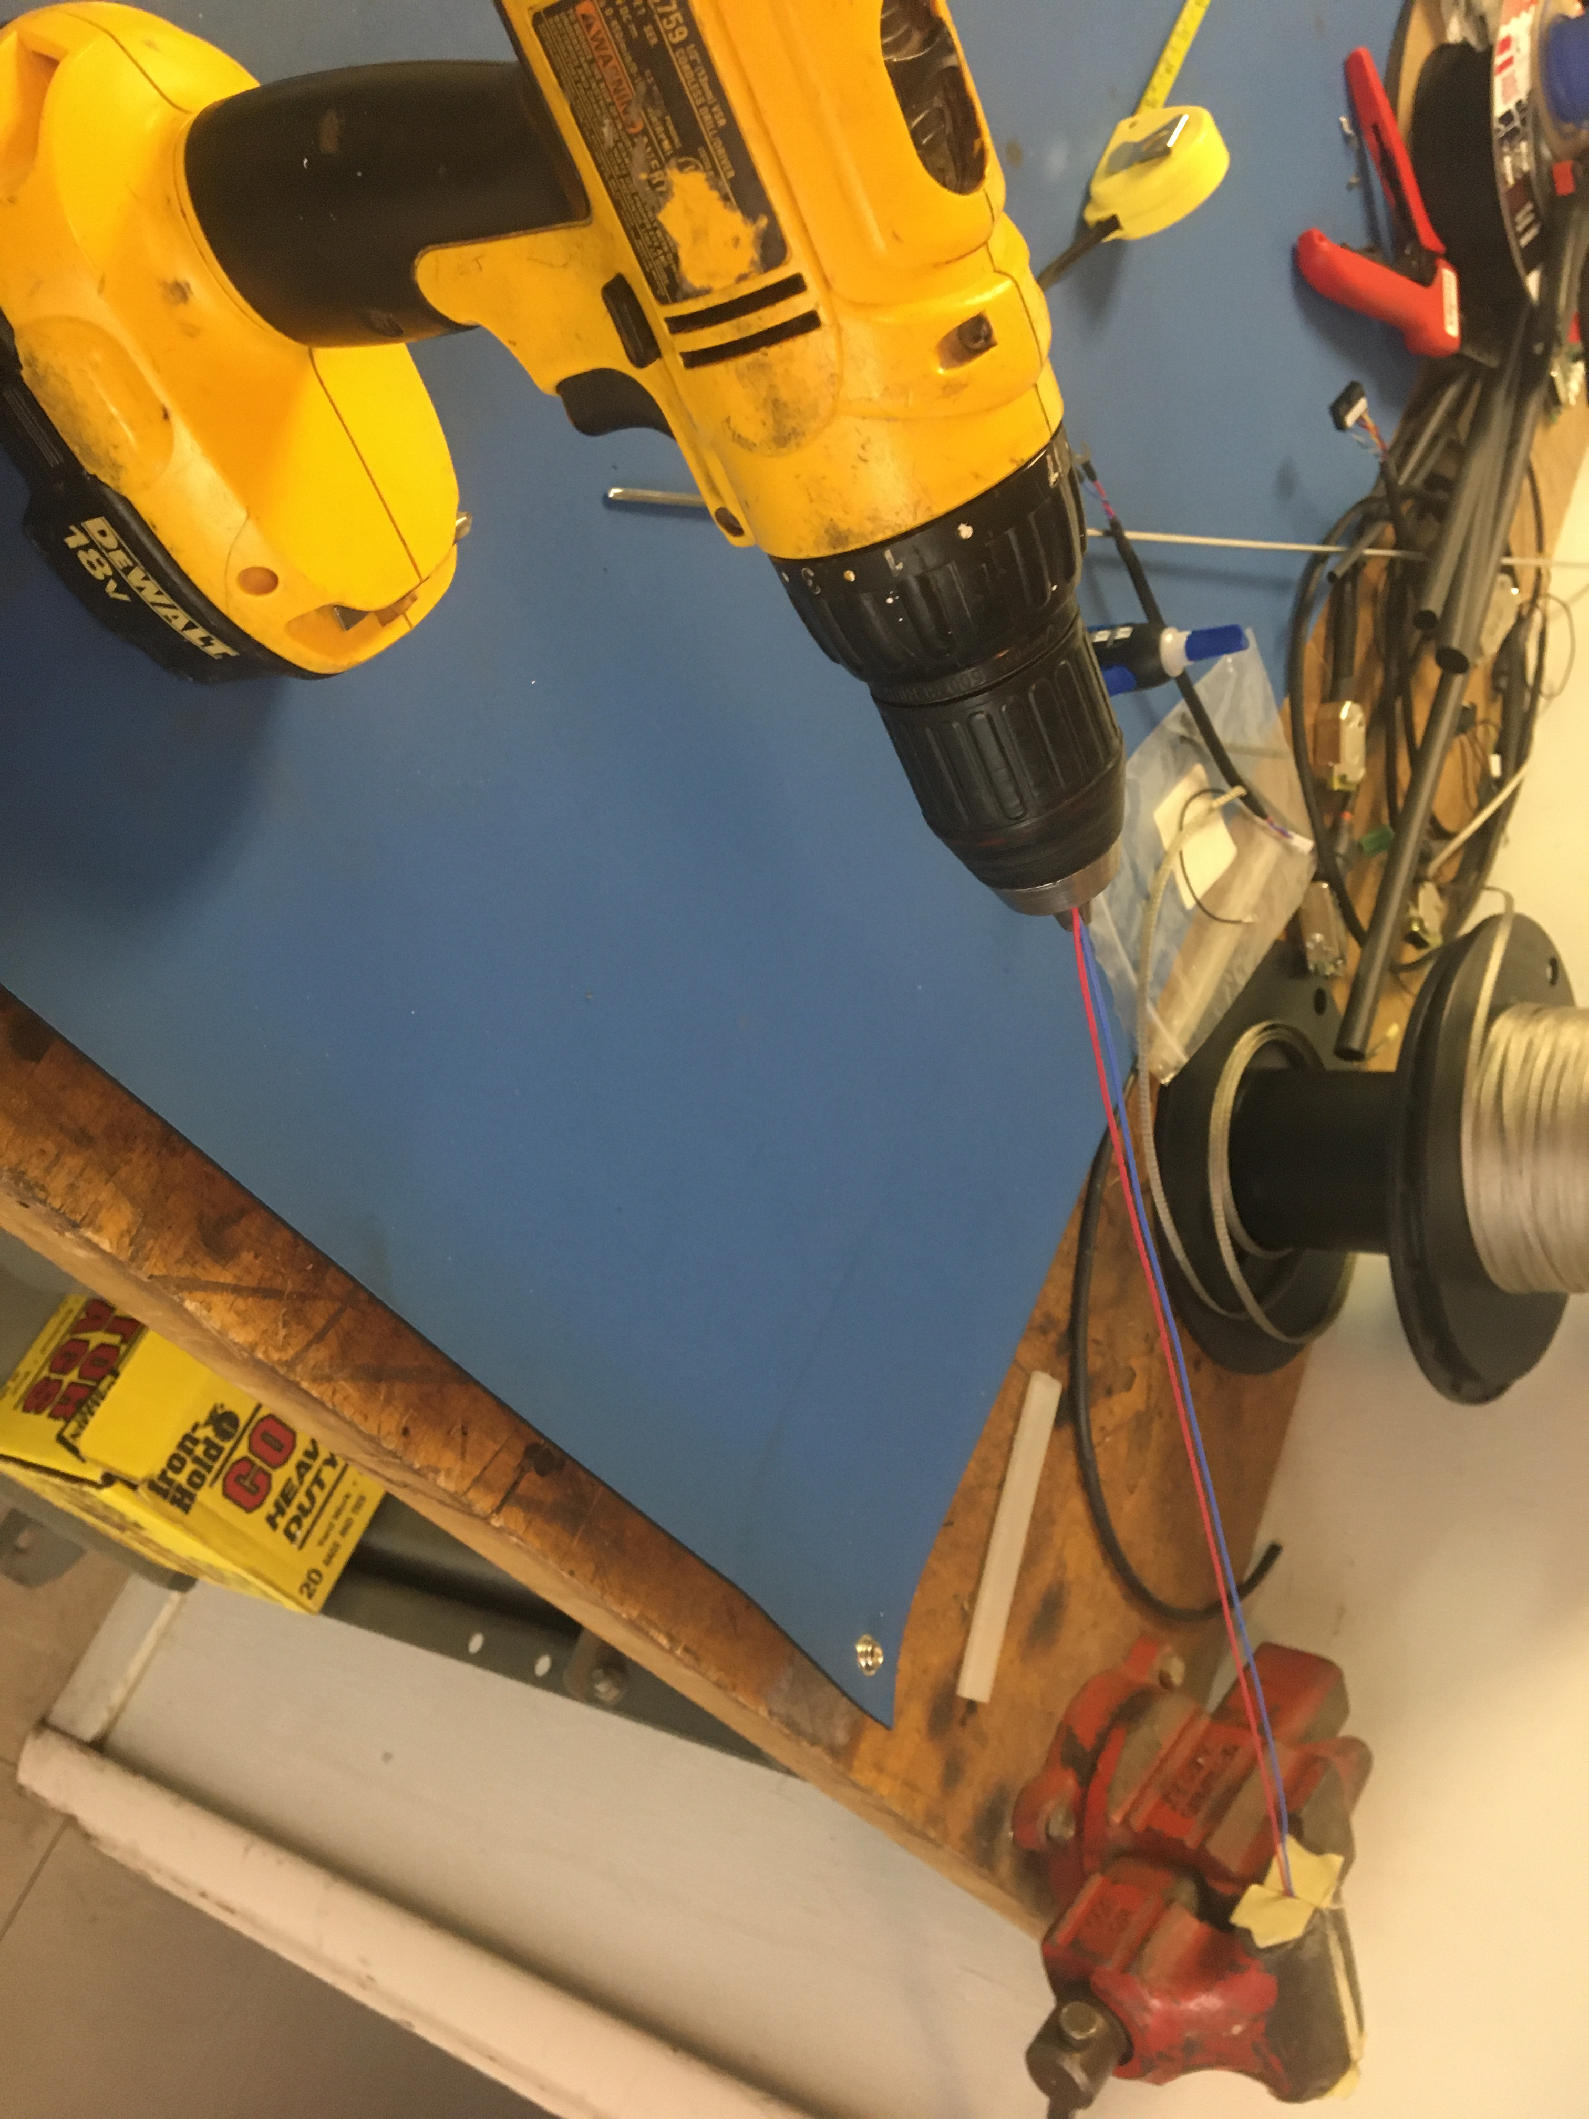
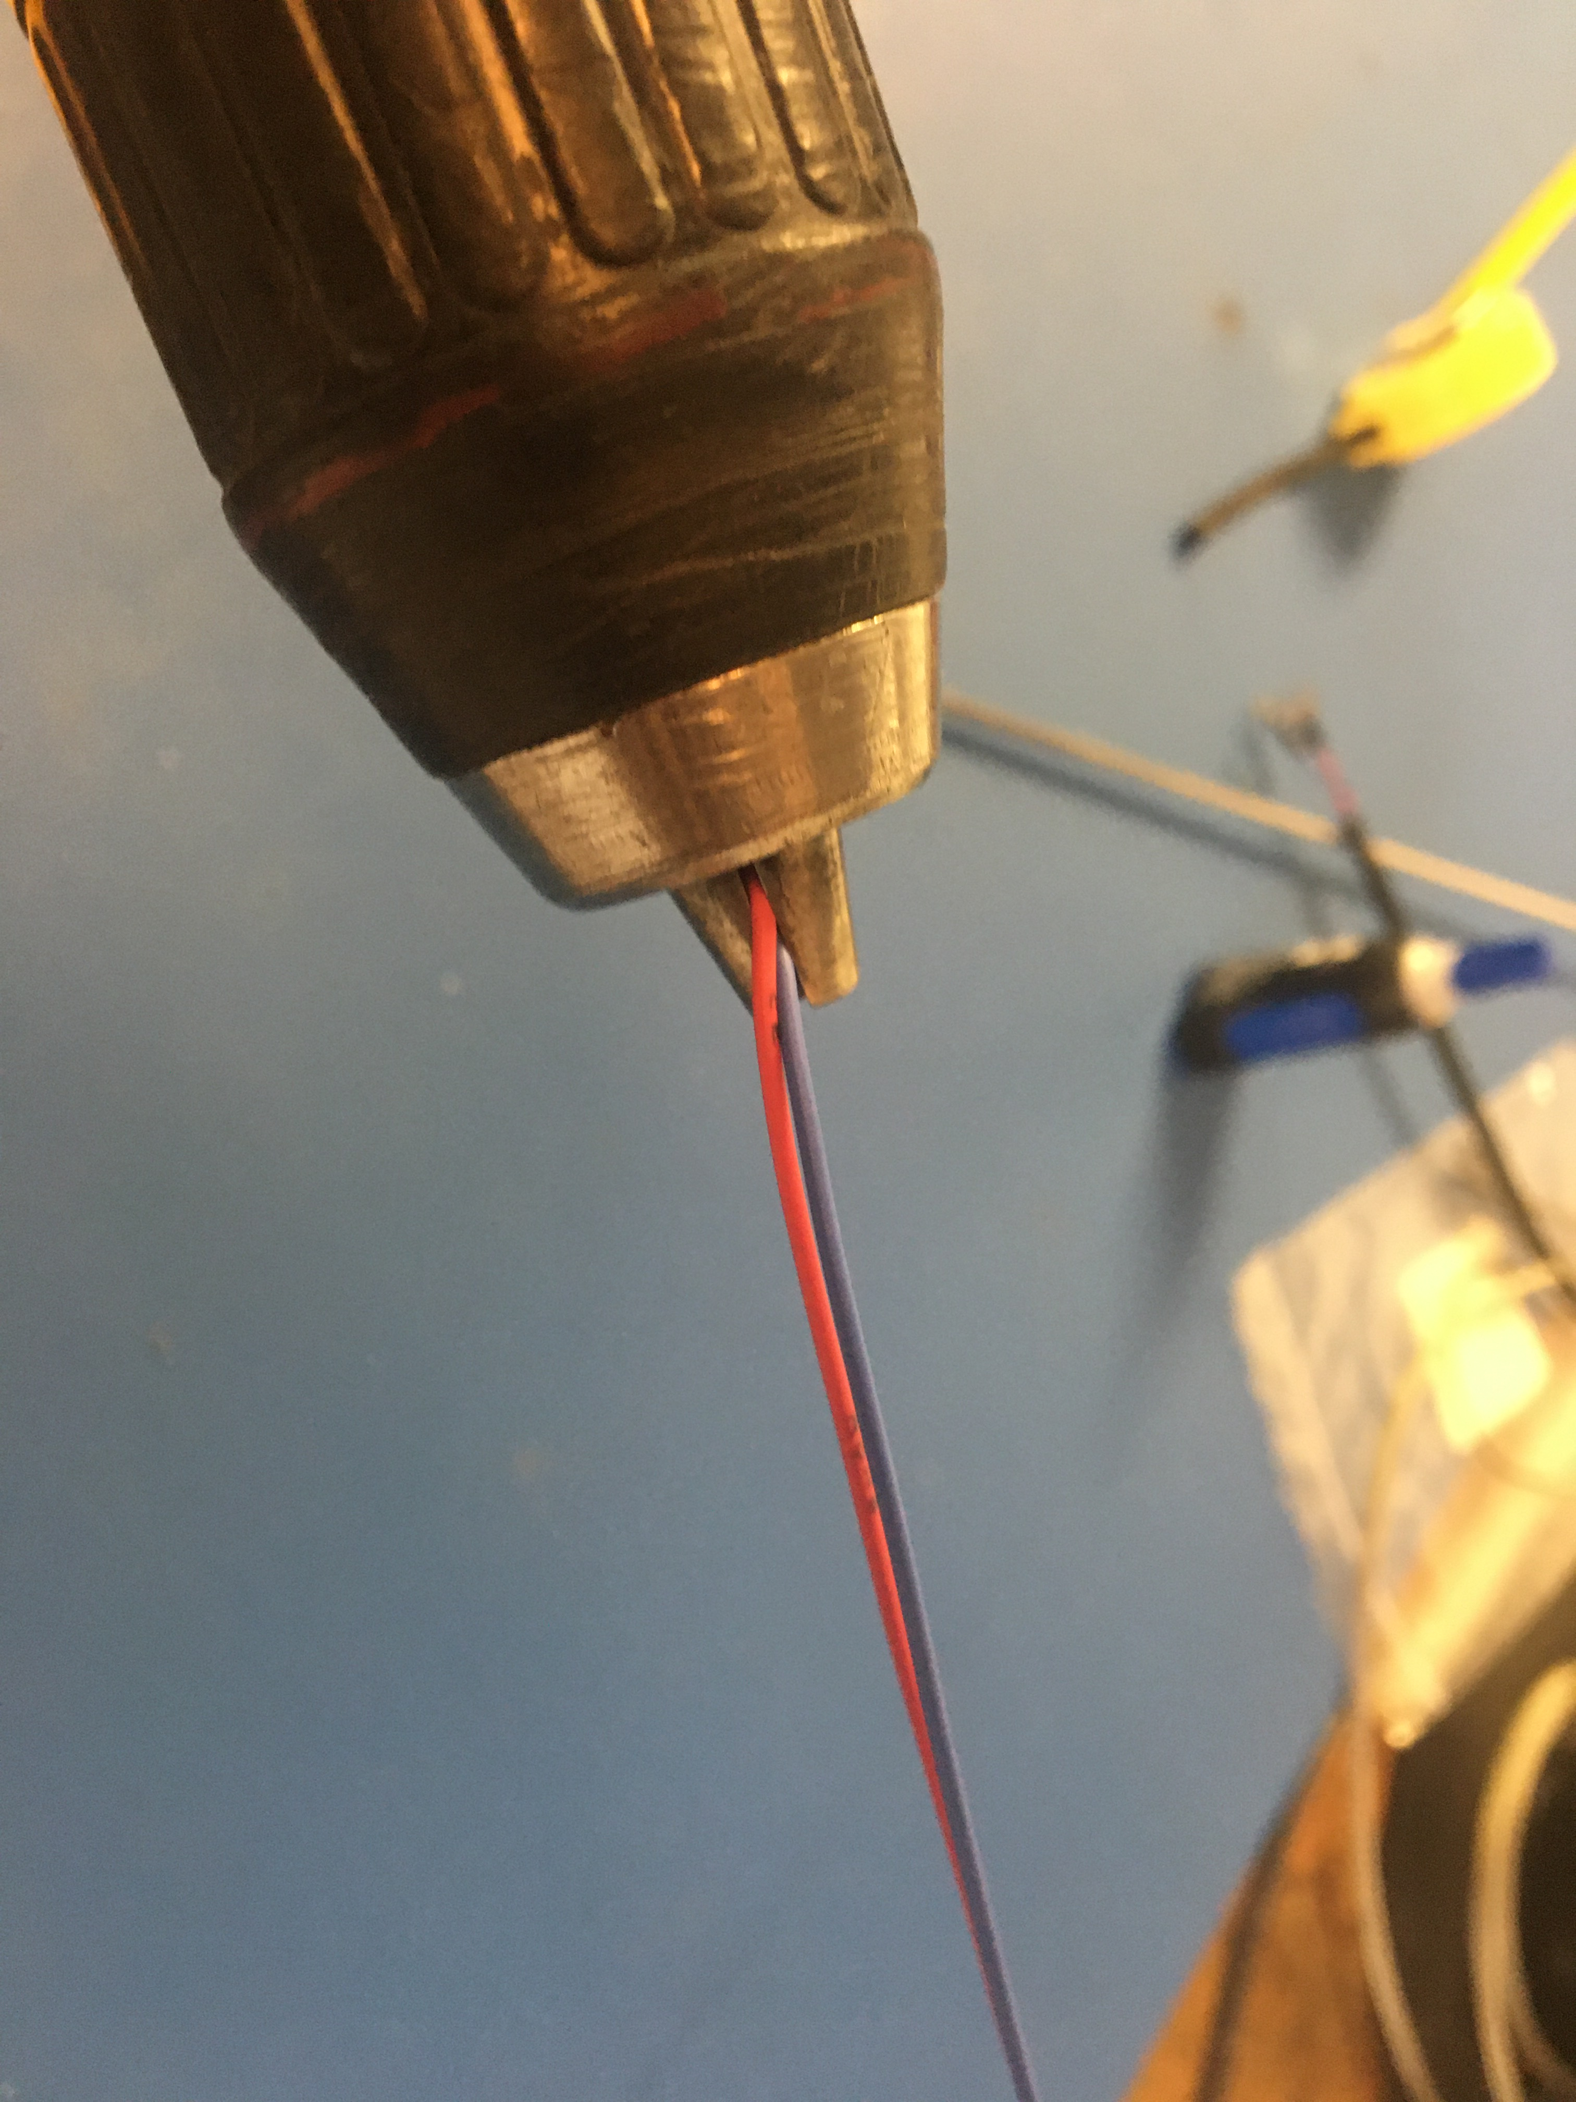
Line the workshop vise with masking tape (this prevents the wires from sheering when they are twisted with the drill). Place one end of the wires in the vise and the other in the drill as shown. Make sure the wires are pinched tightly in both the vise and drill so they don’t come loose. Run the drill to twist the wires together. See next slide for how tightly the wires should be twisted.

Slide 8
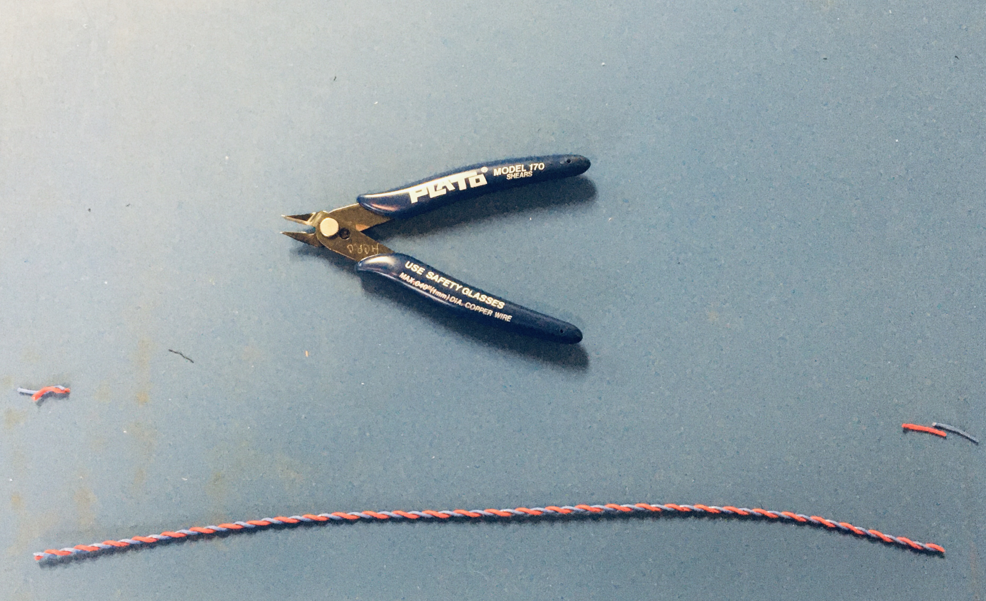
The twisted pair should be about 14in long. Cut the ends of the wire where it’s been pinched by the vise and drill.

Slide 9
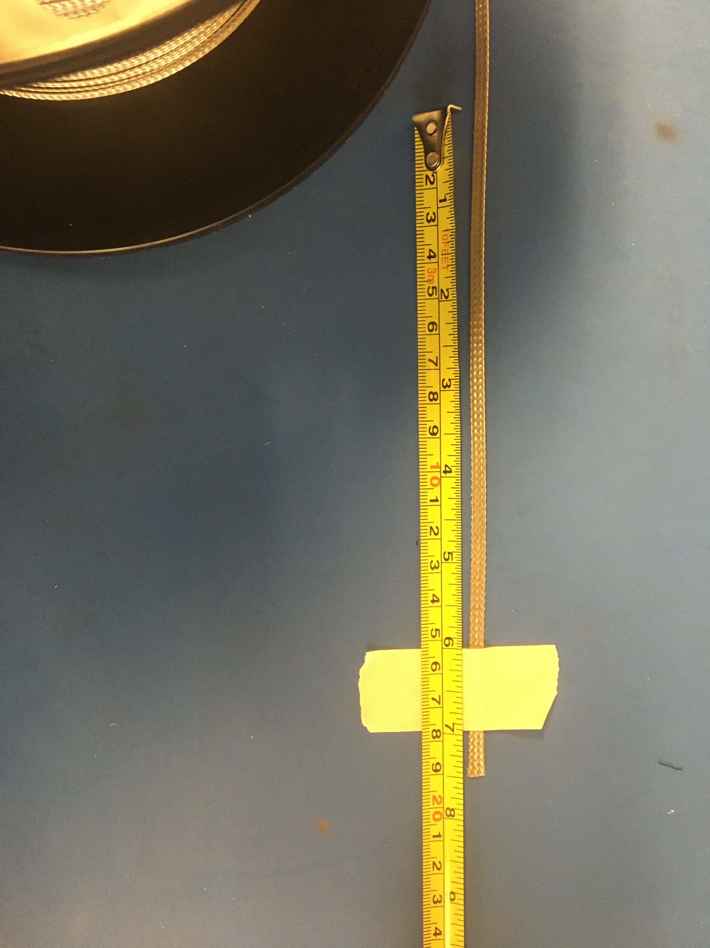
Measure out and cut 7 ½ inches of the metal braid

Slide 10
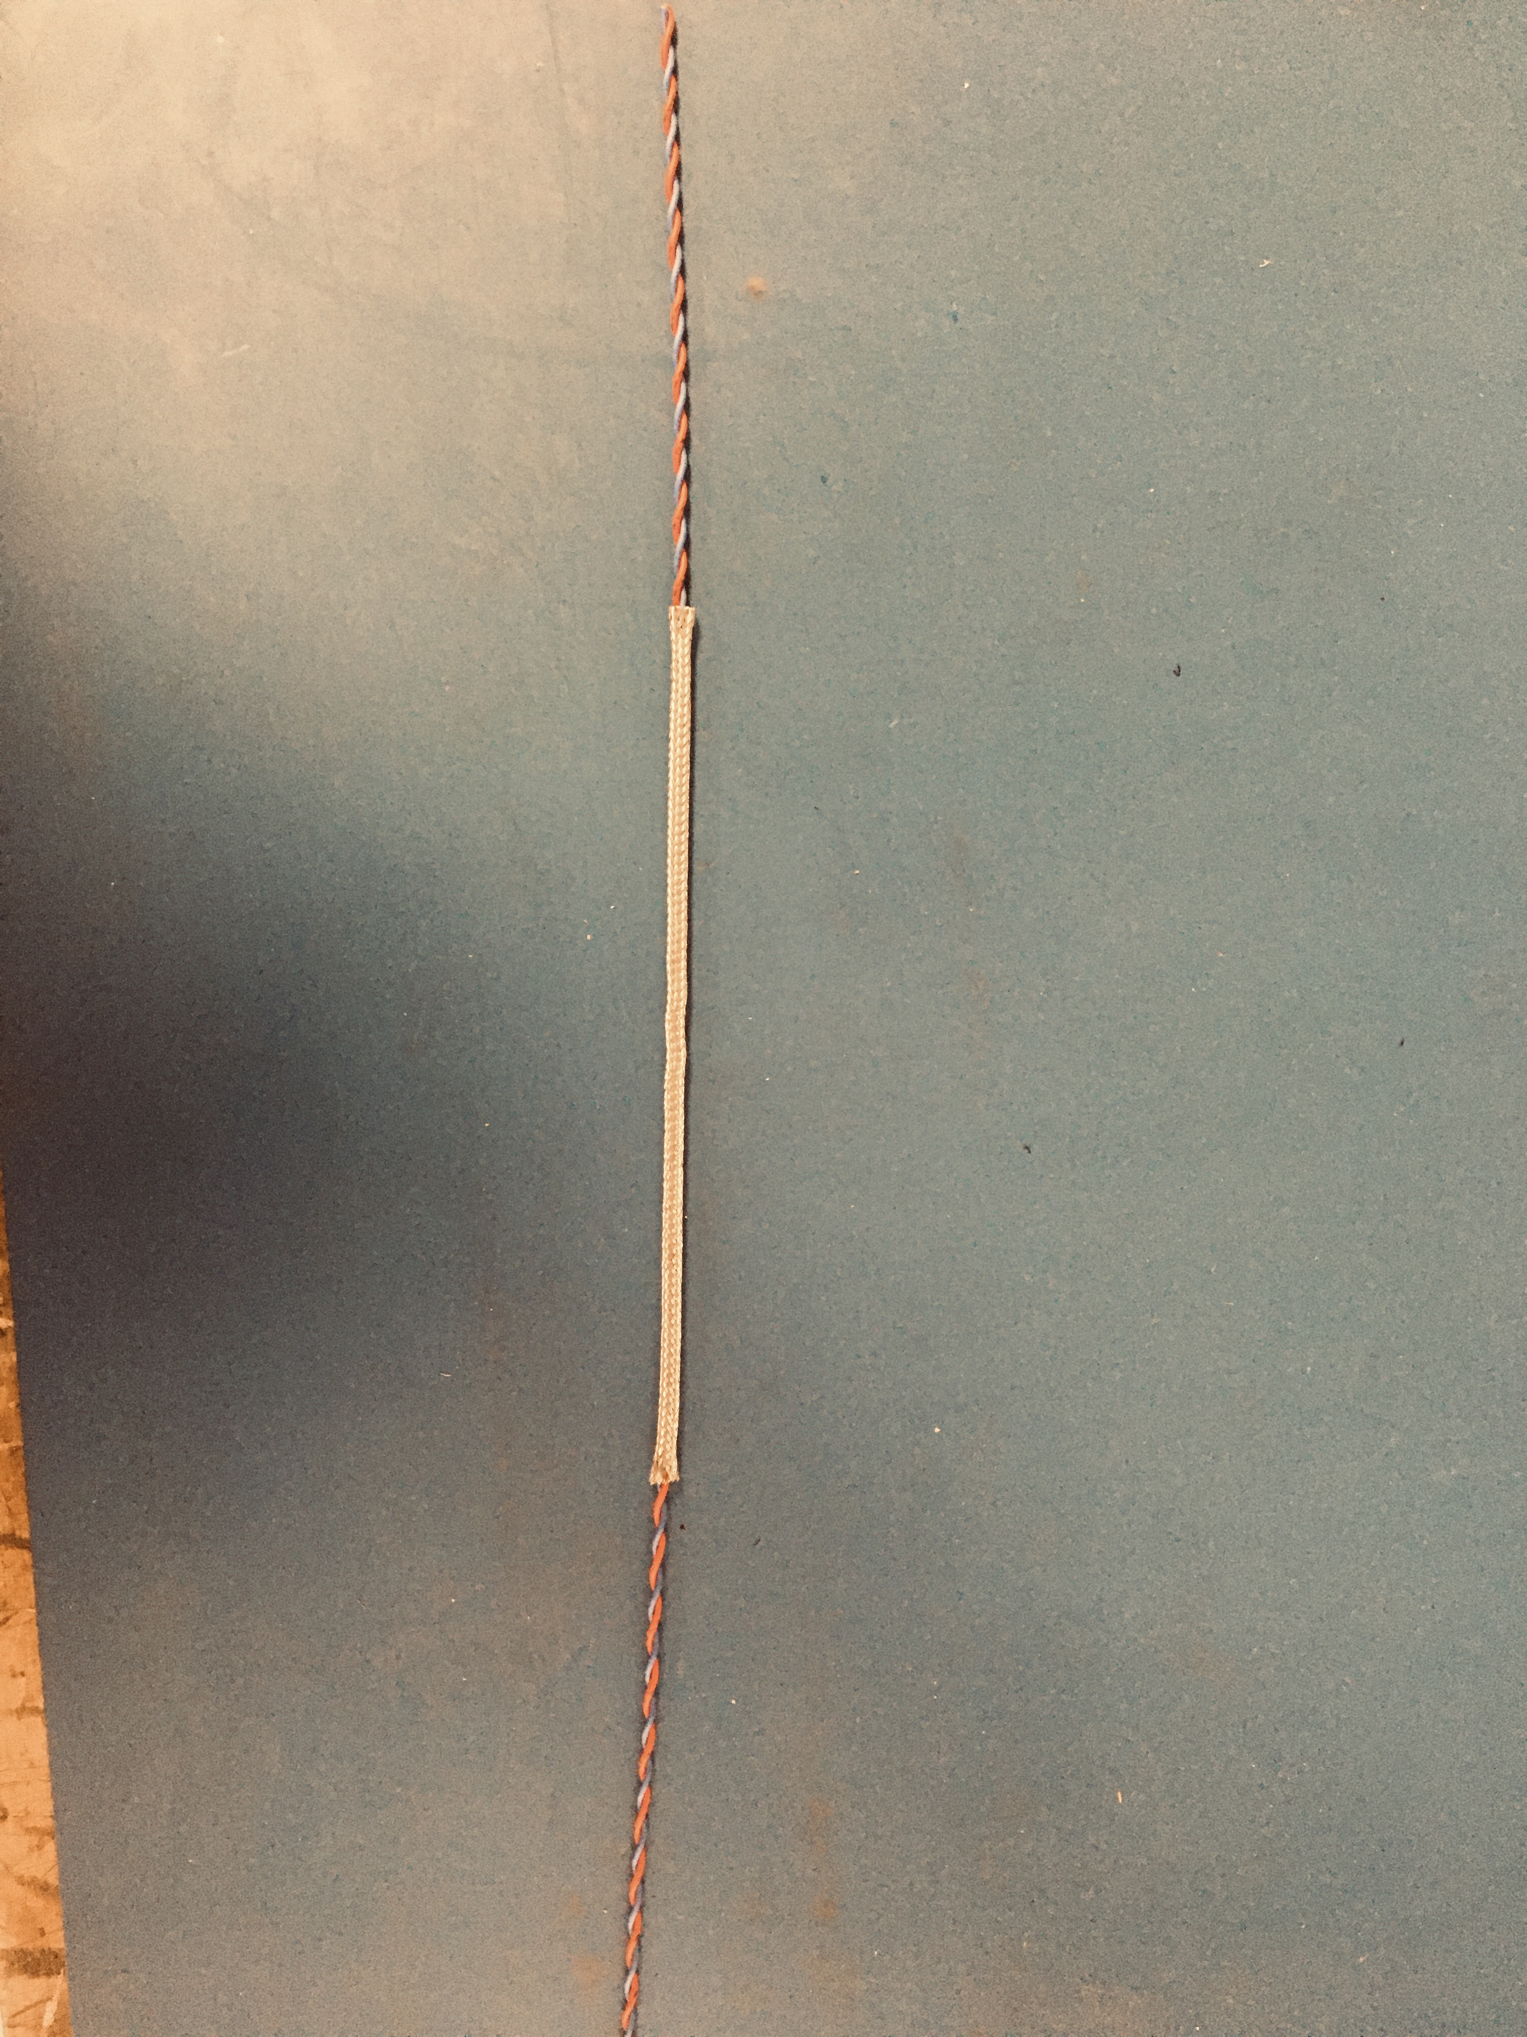
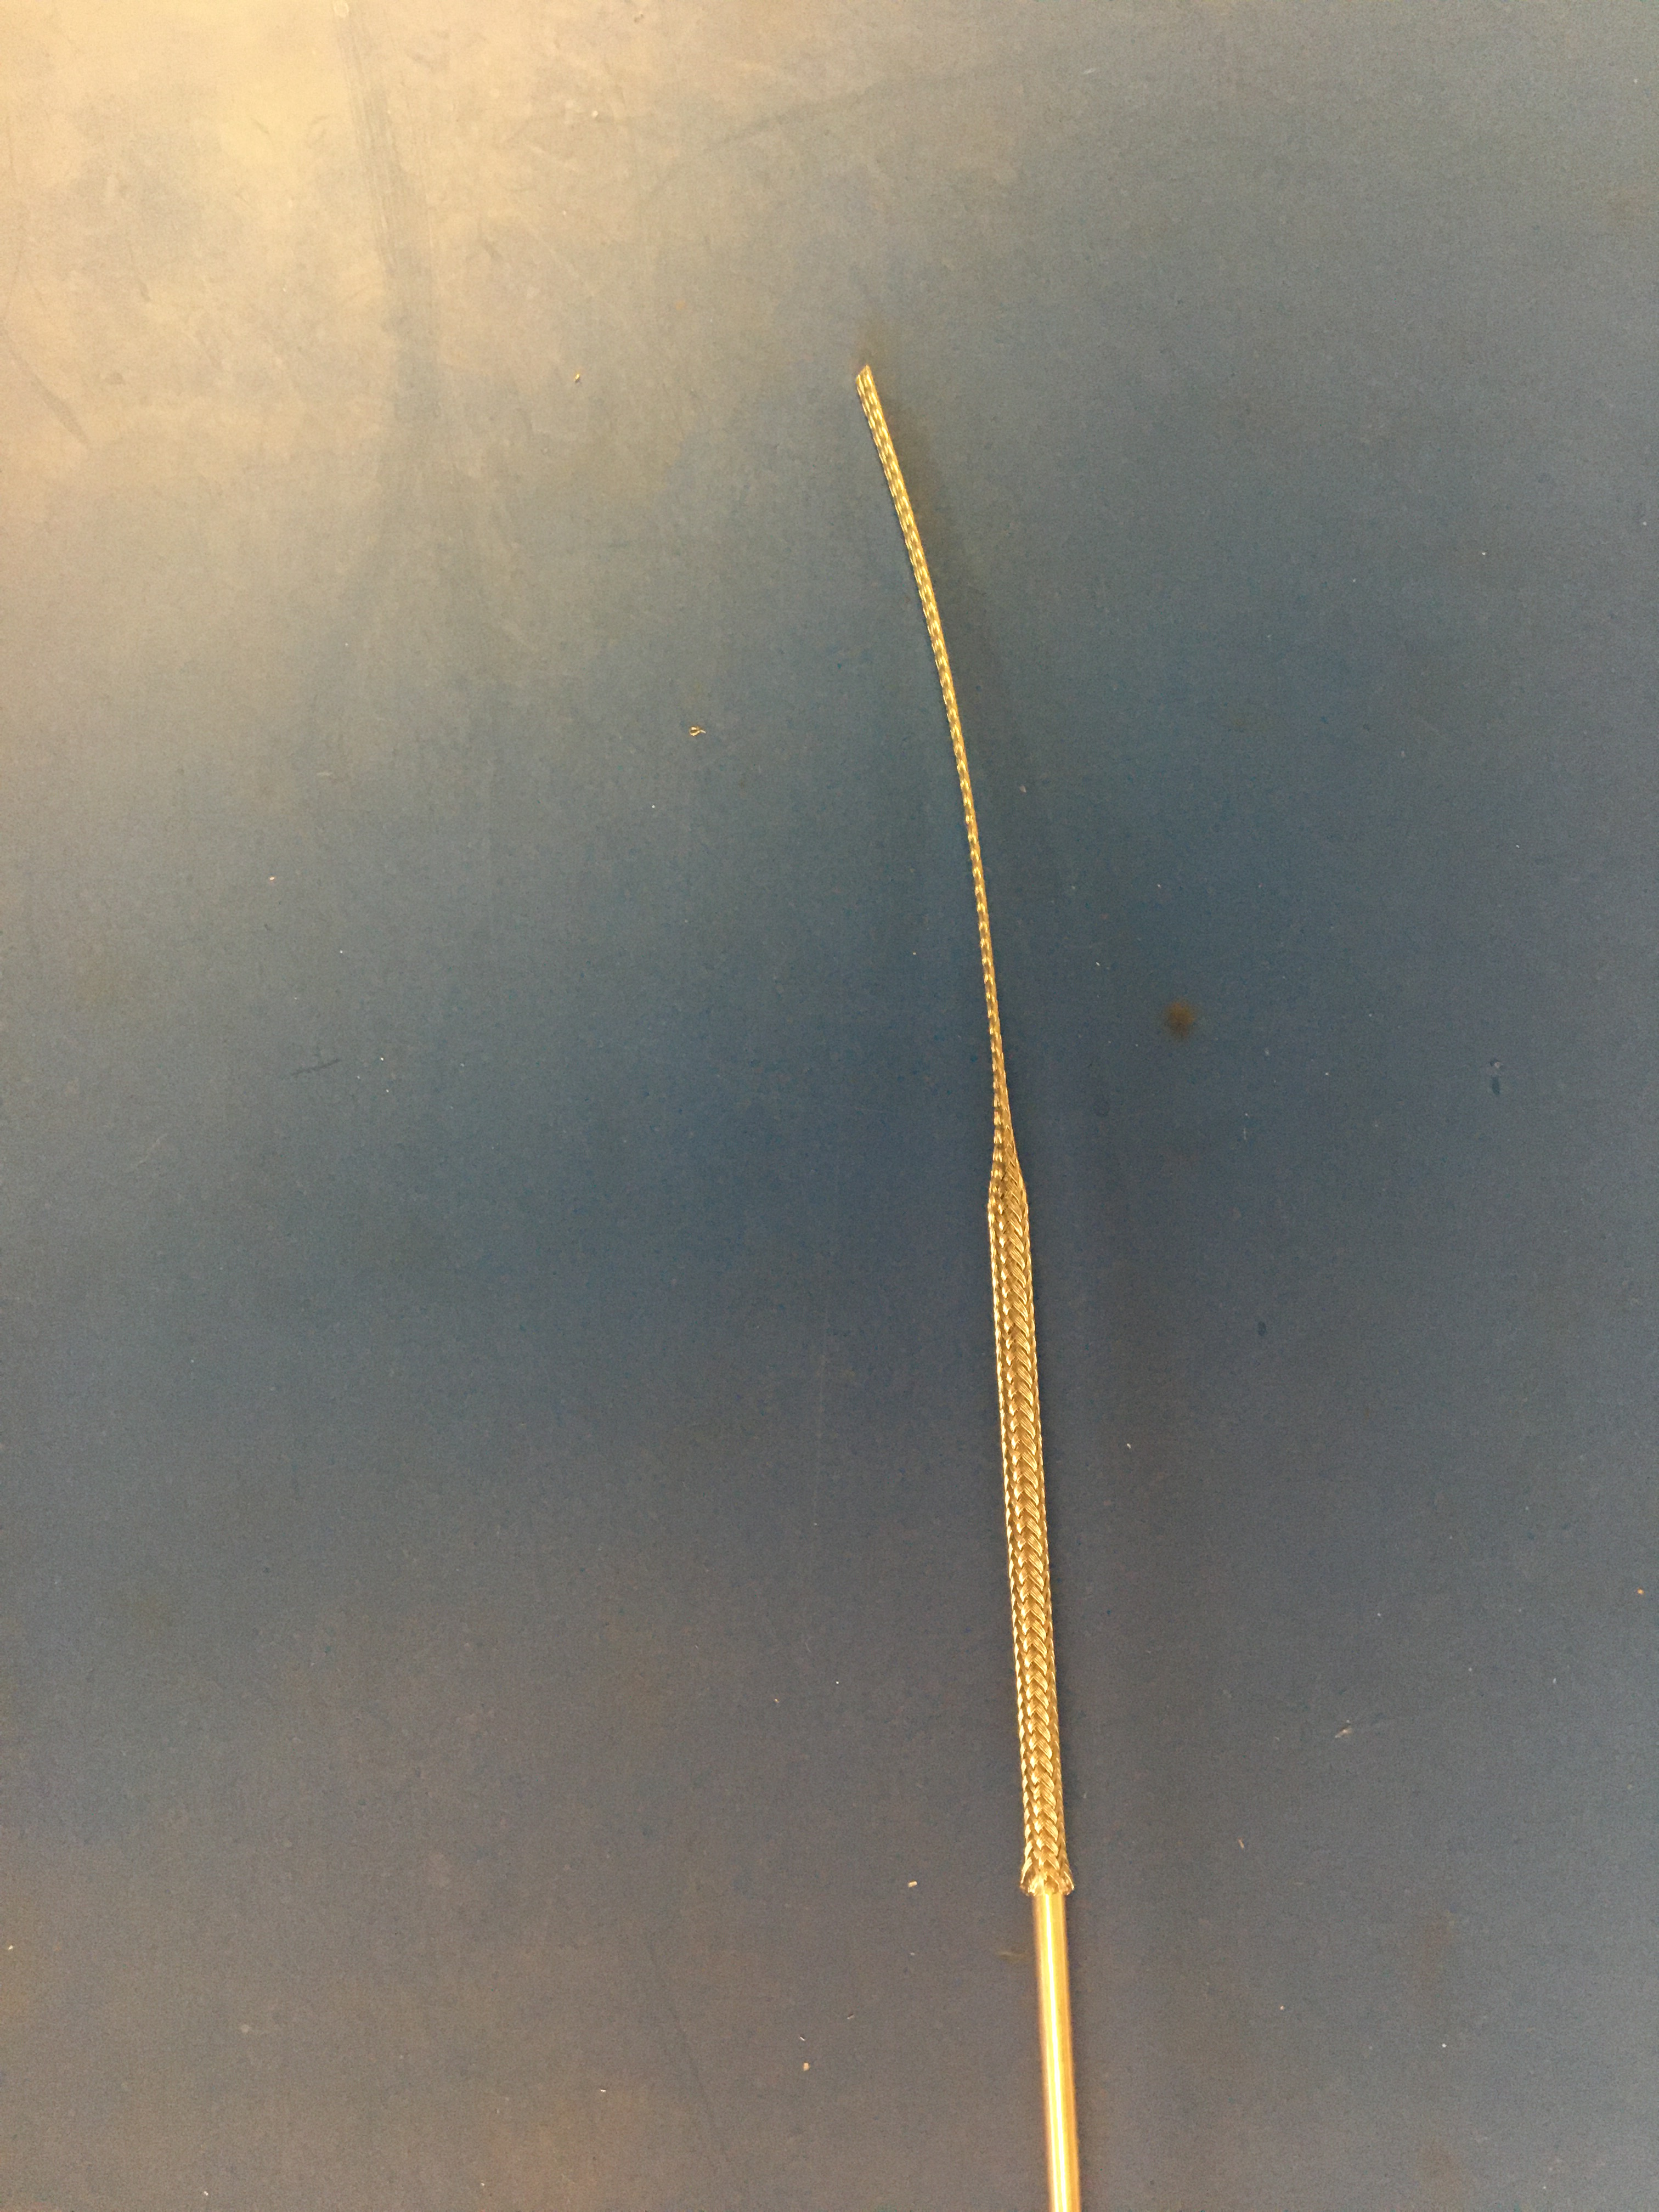
Expand metal braid with metal rod. Thread twisted pair through so the ends sticking out of the metal braid are equal.

Slide 11
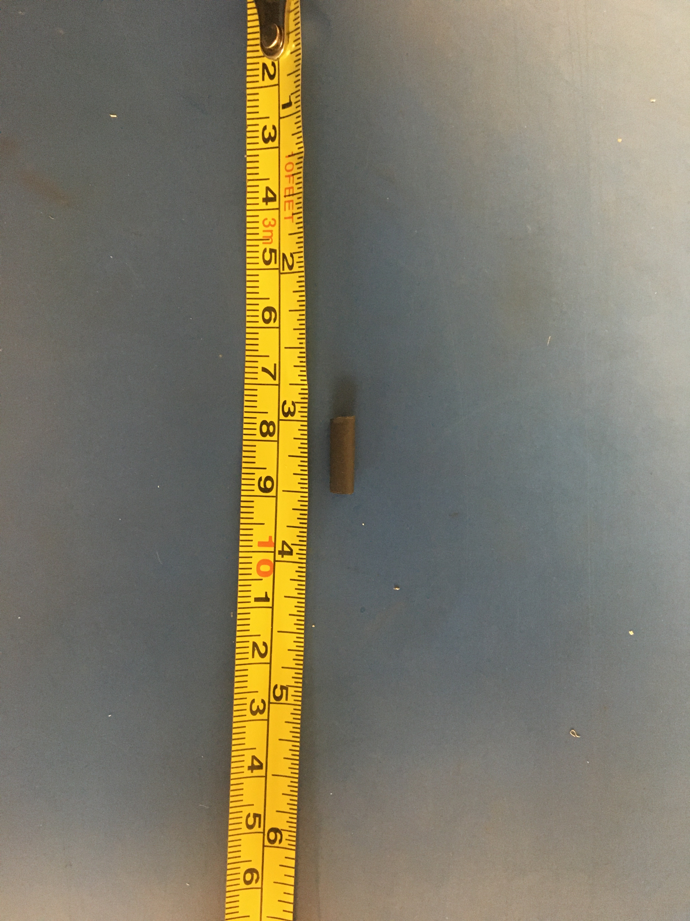
Measure out and cut two ½ inch of the 1/8th adhesive shrink tube

Slide 12
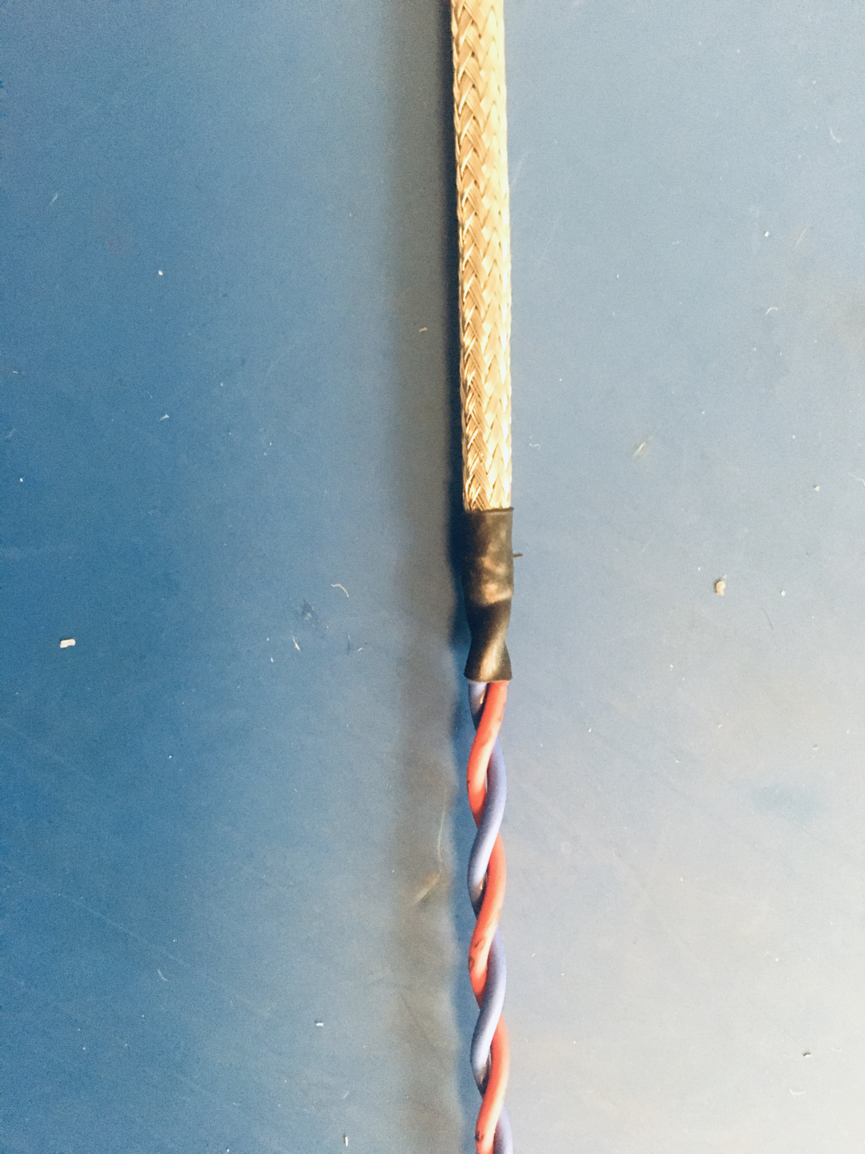
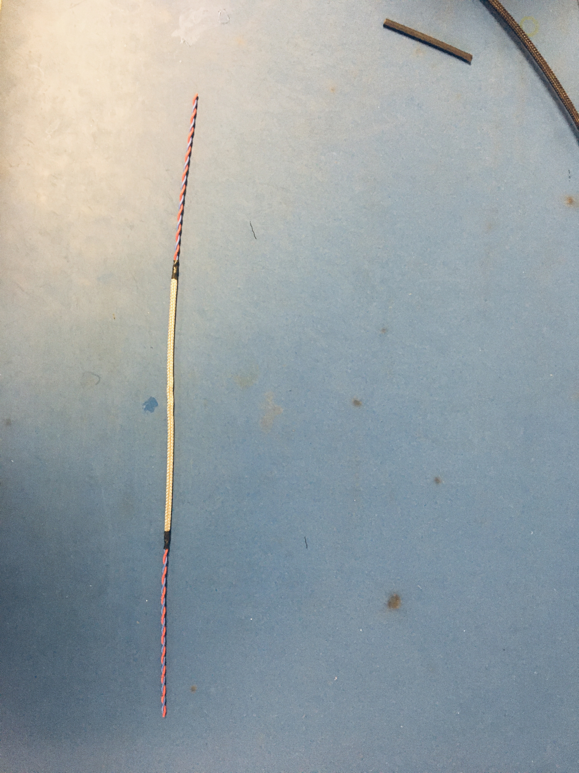
Put shrink tube on the metal braid and wire joint such that the metal braid ends in the middle of the shrink tube. Then apply the heat gun so the shrink tube shrinks all the way down. Complete this process on both metal braid ends. Once the shrink tube cools the metal braid should no longer be able to move.
End of metal braid

Slide 13
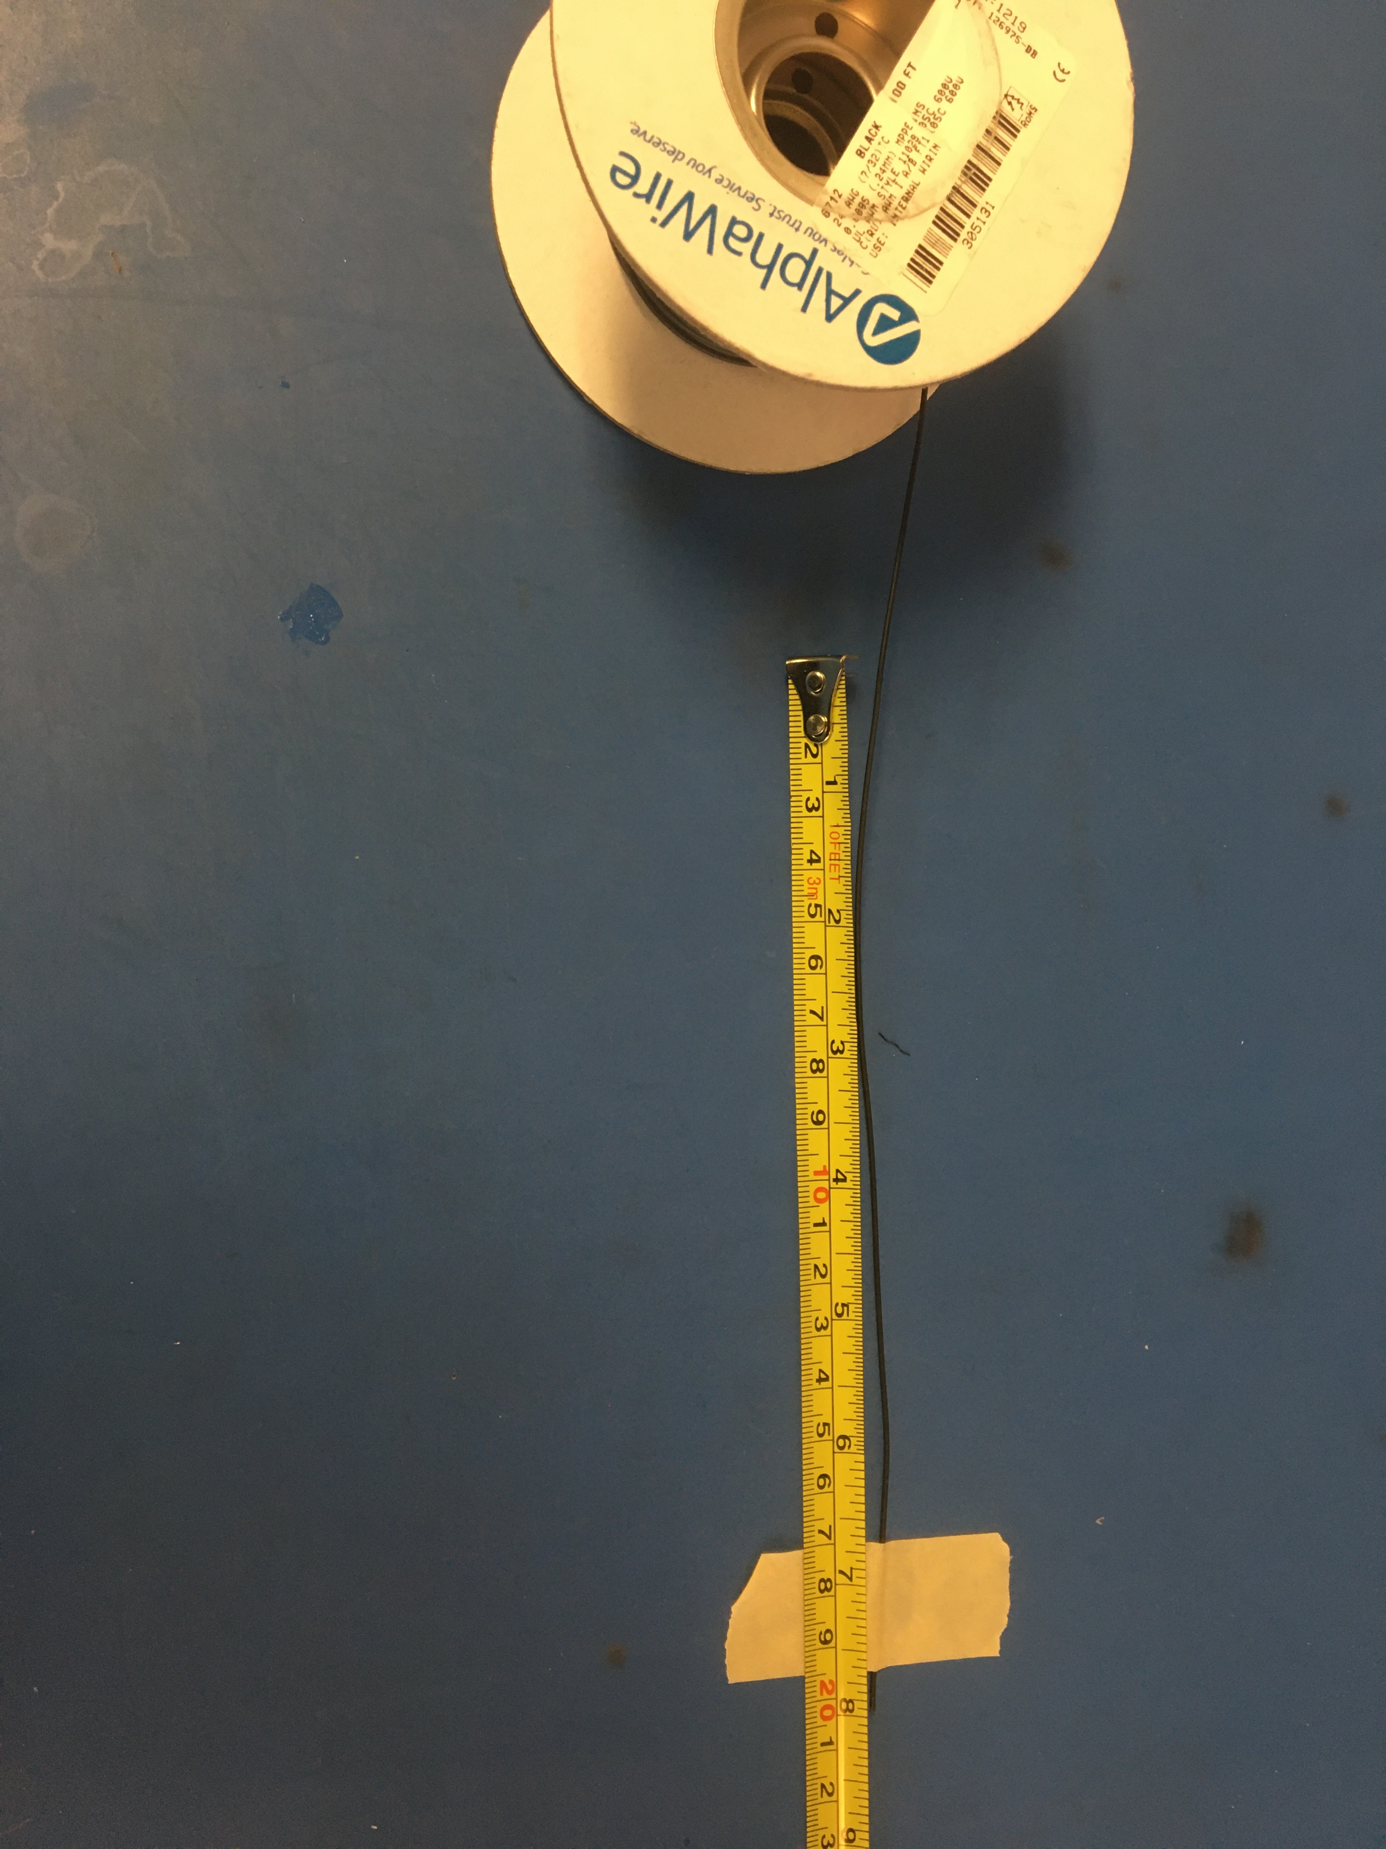
Measure out and cut 8 inches of the black 24 awg wire

Slide 14
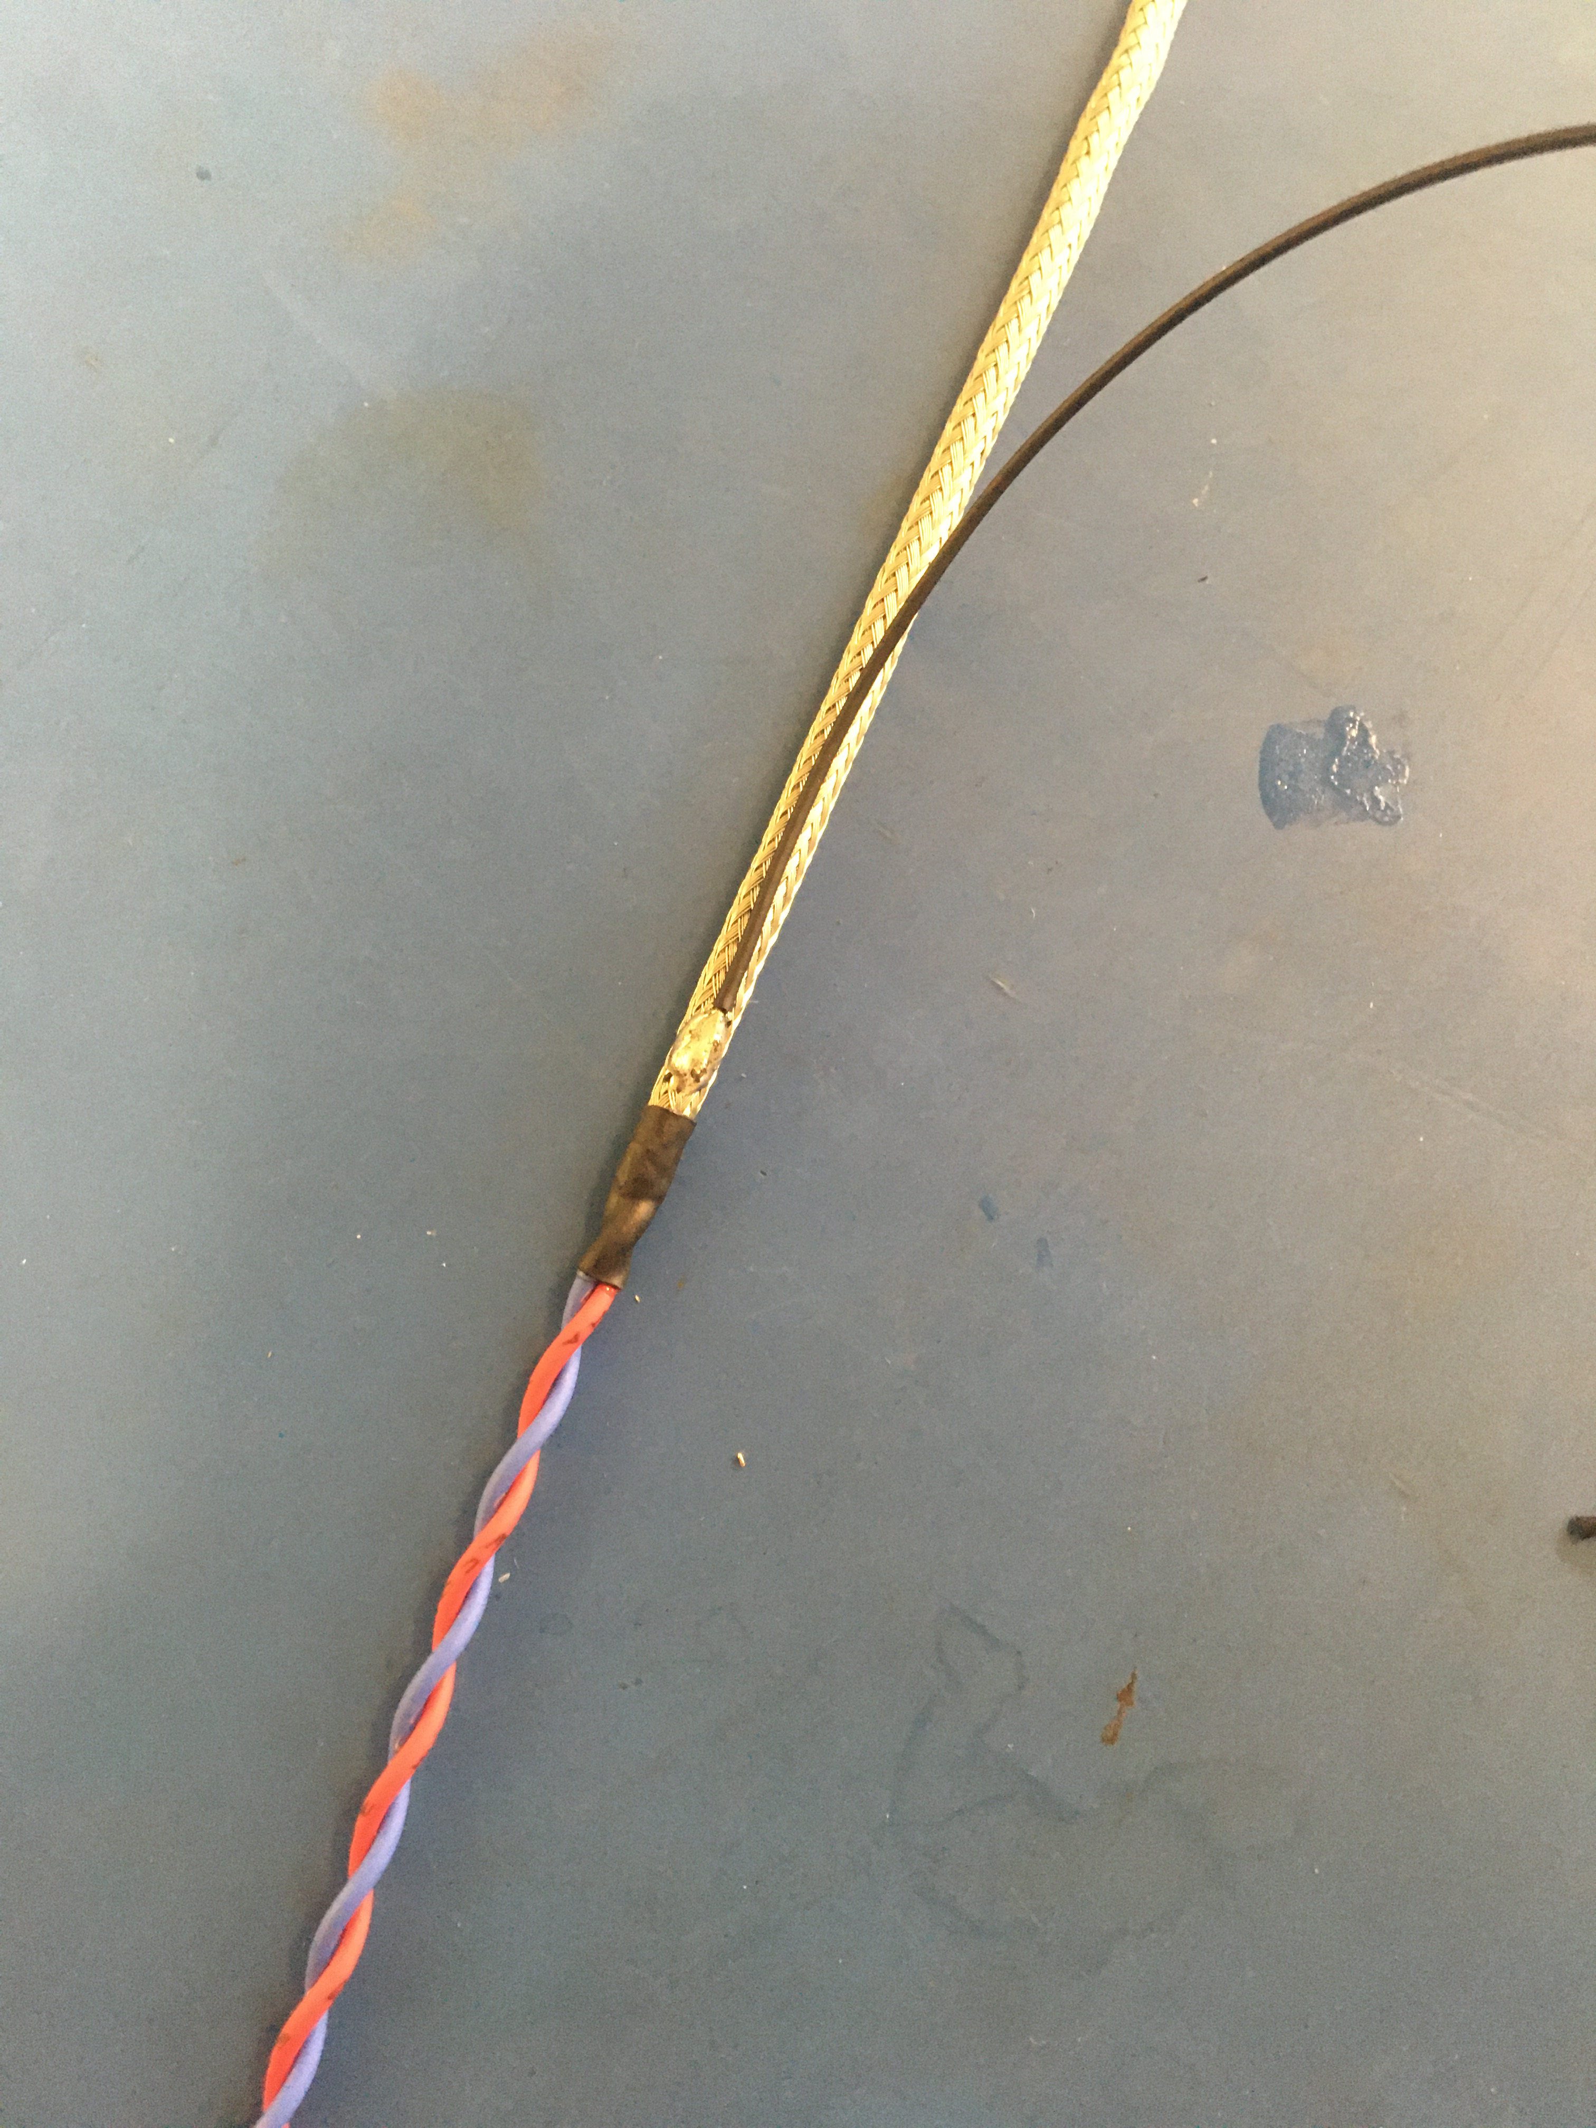
Strip an end of the black 24 awg wire and solder it at one of the metal braid joints such that rest of the black wire runs along the metal braid.
Ground wire goes this way

Slide 15
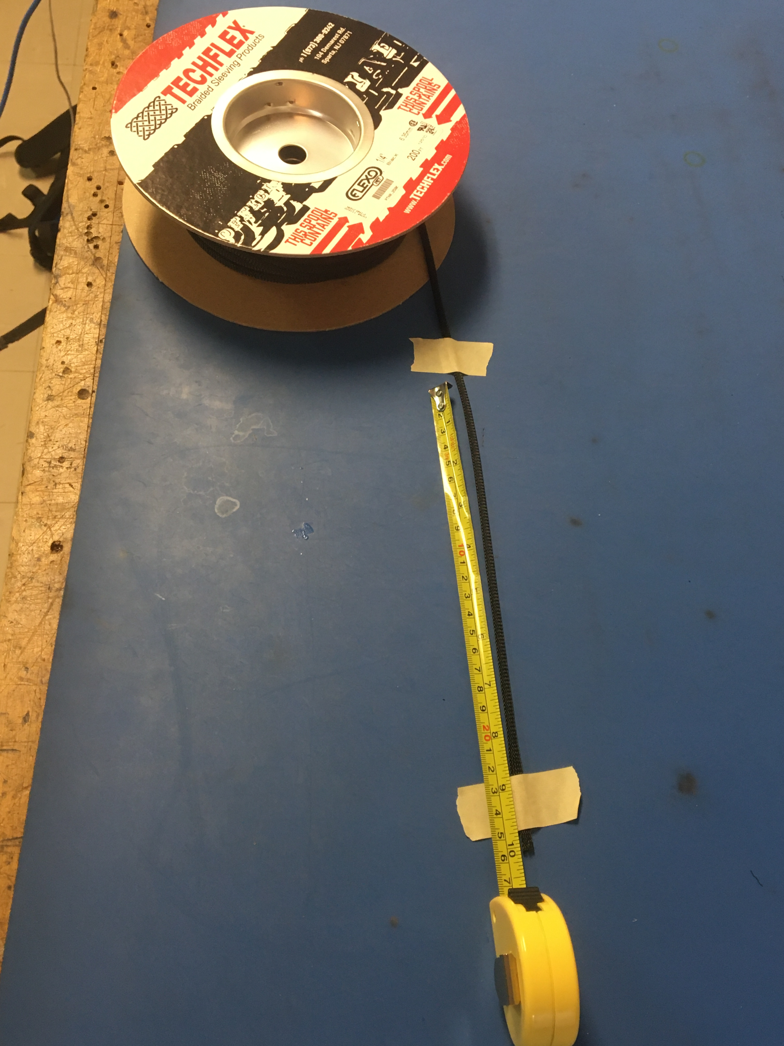
Measure out and cut 10 inches of the plastic braid

Slide 16
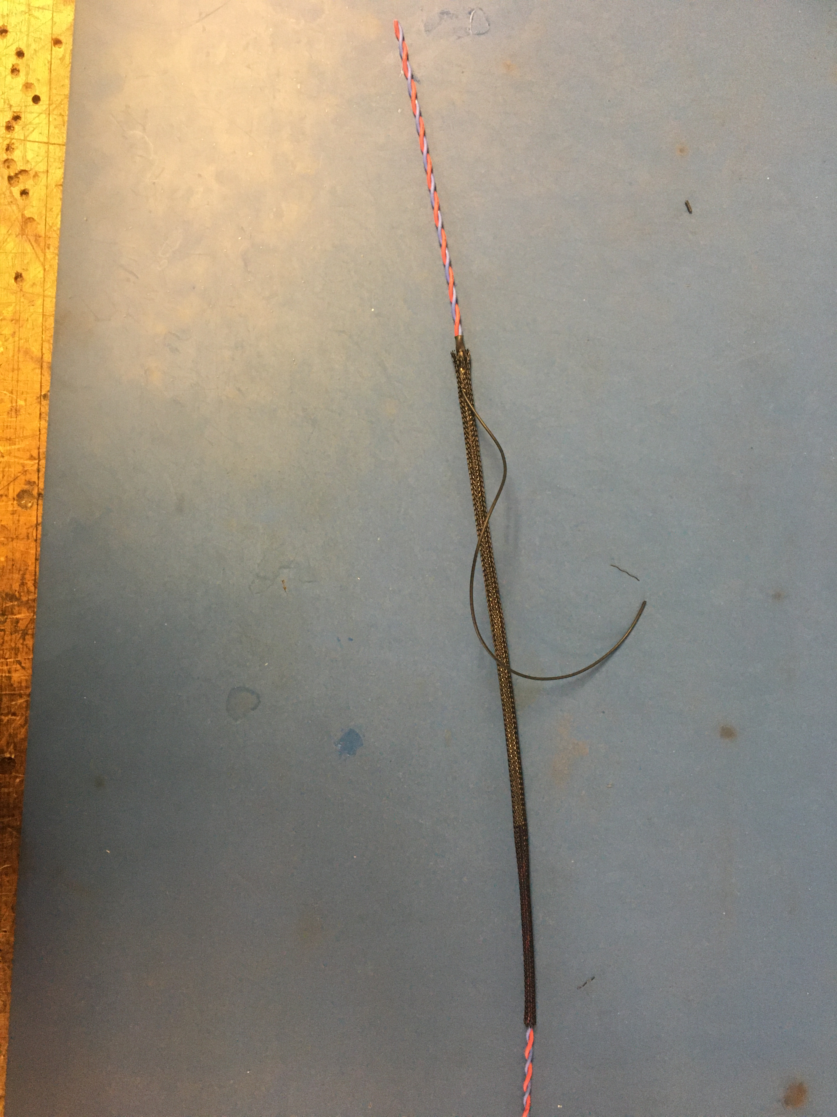
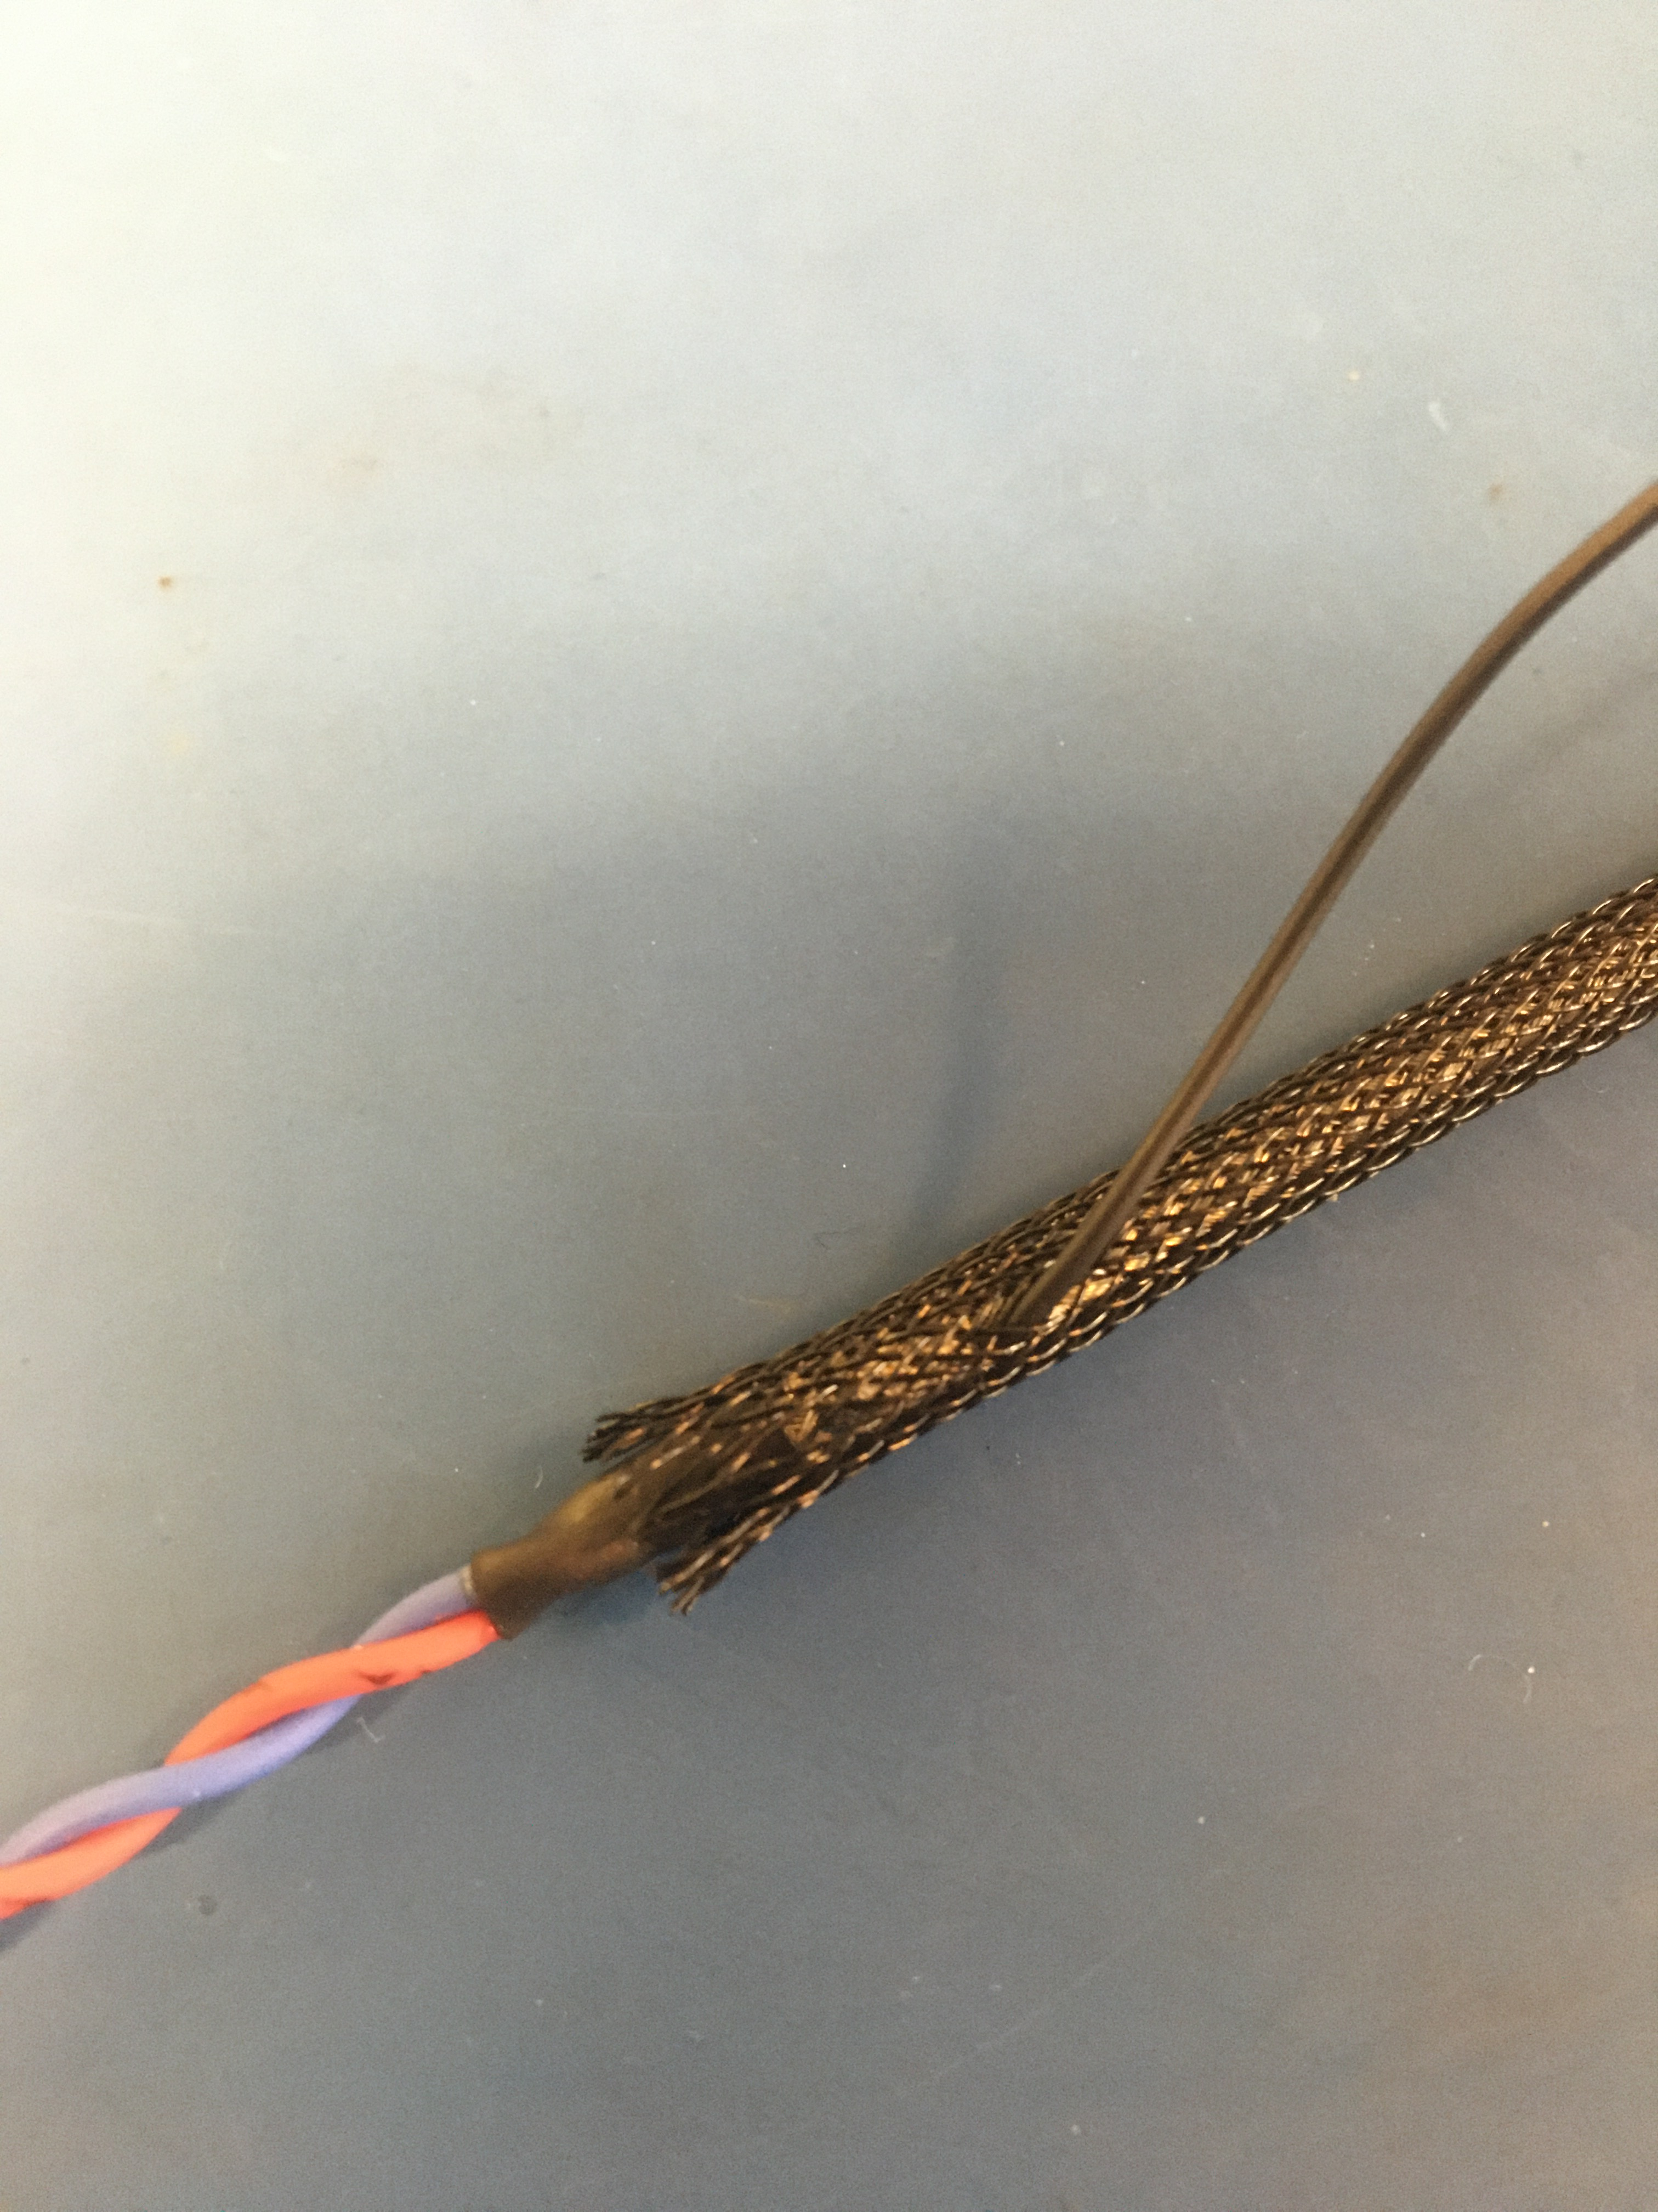
Slide on plastic braid onto the twisted pair from the end WITHOUT the ground wire and over the metal braid. Slide the plastic braid toward ground wire. Take end of ground wire and poke it through a hole in the plastic braid about and inch from the end. This placement of the ground wire through the braid should result in the end of the plastic braid hitting the middle of the shrink tube.
About 1 inch
End of plastic braid
About 1 inch
Put plastic braid on from the bottom end
Shrink tube

Slide 17
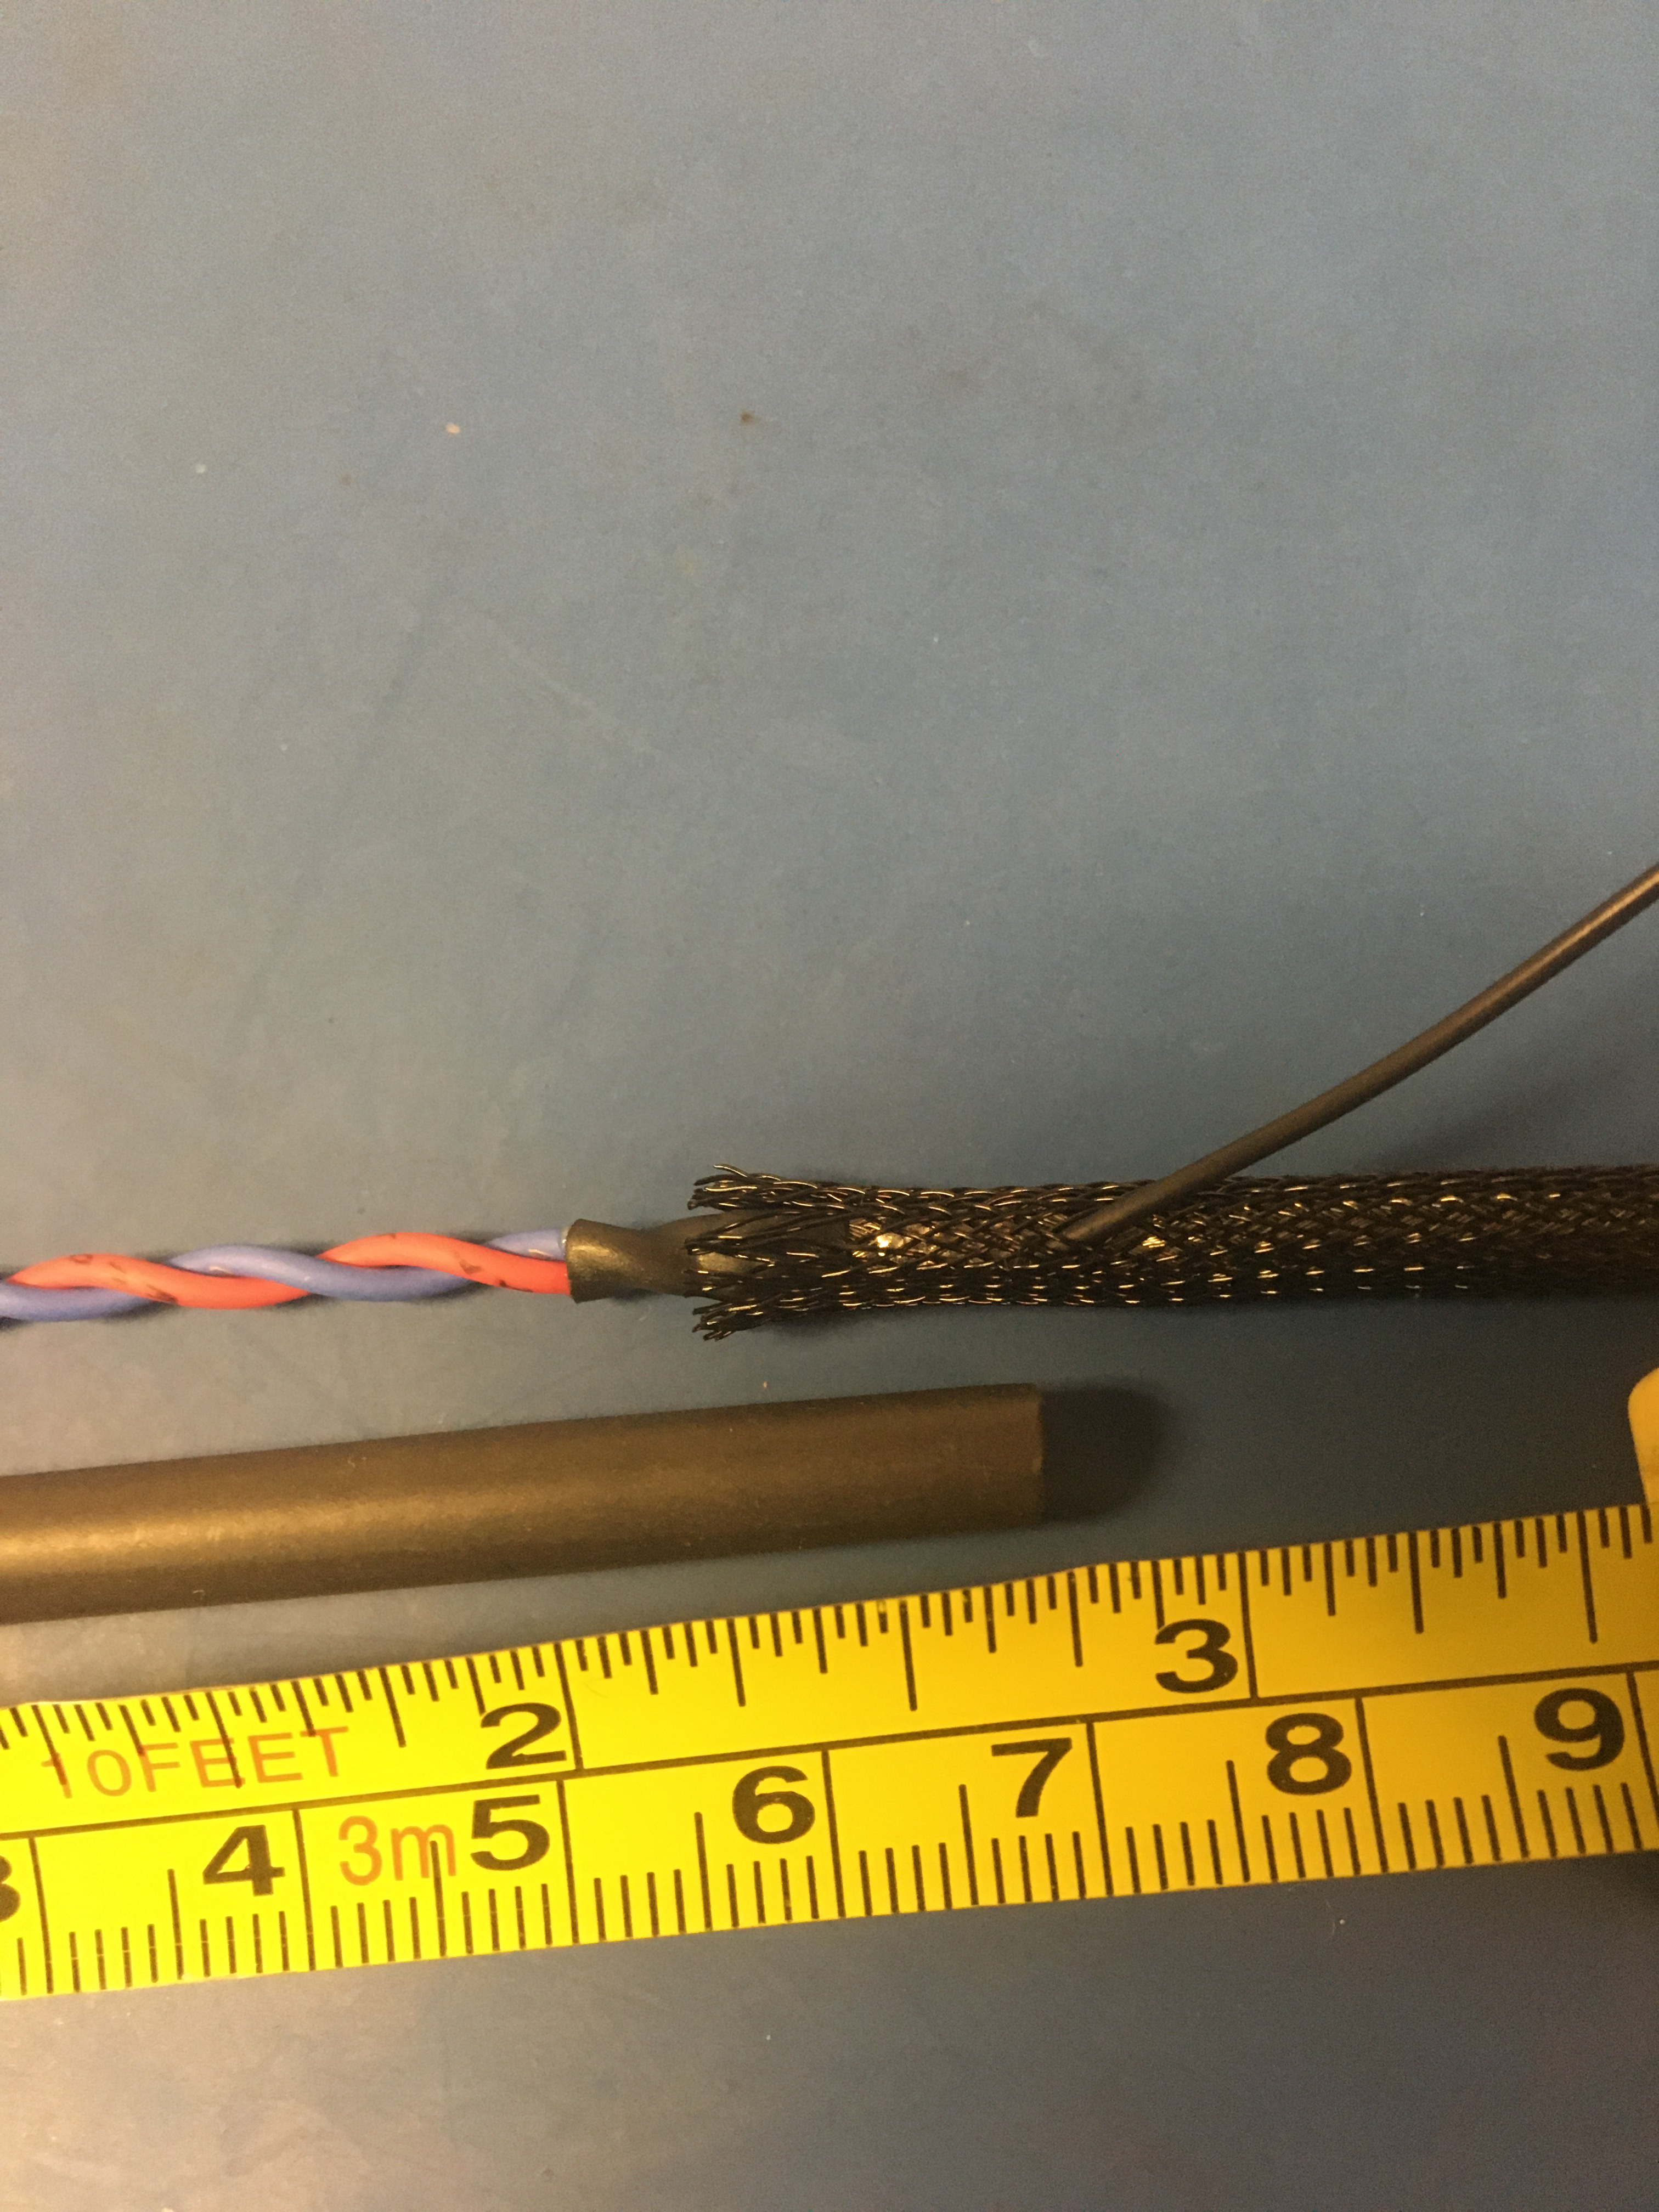
Measure out and cut 3/4 inch of 4.8 mm adhesive shrink tube. Ensure that this length of shrink tube will cover the solder joint of the ground cable and will extend to the end of the shrink tube covering the metal braid joint.
Shrink tube needs to cover this length

Slide 18
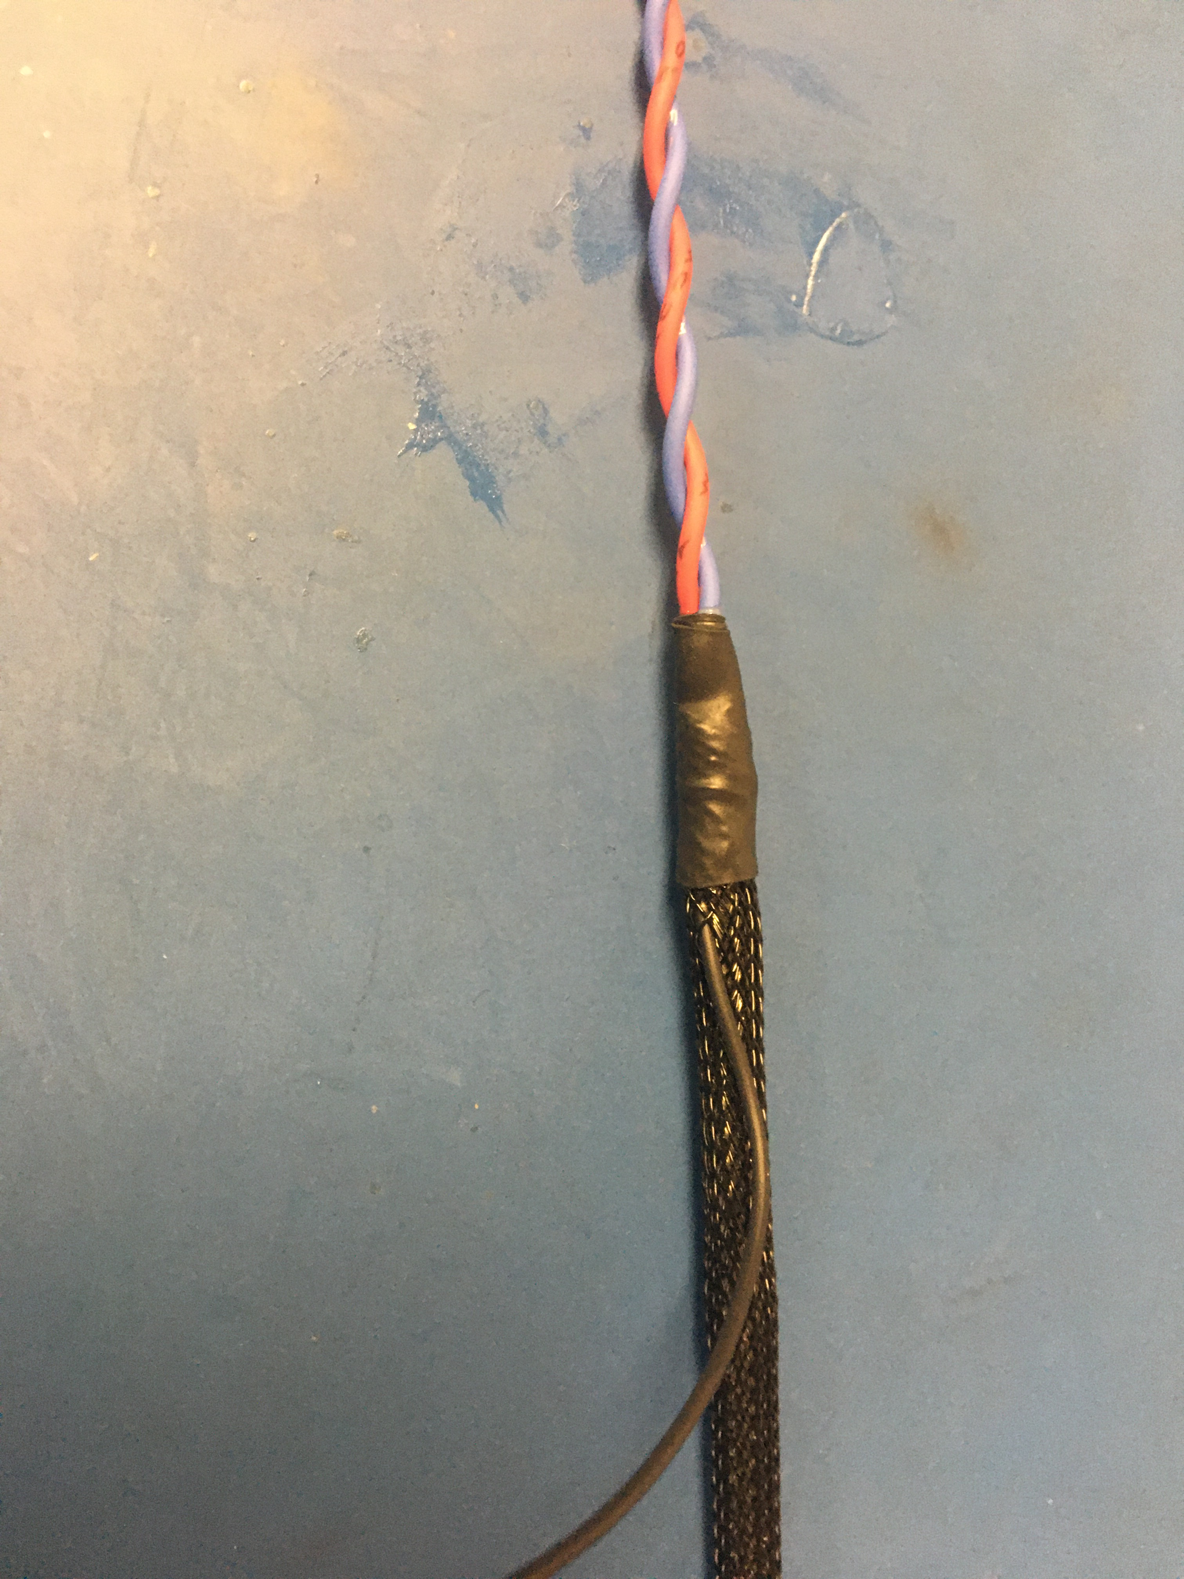
Slip the piece of shrink tube onto the twisted pair and onto the plastic braid & ground wire solder joint. Apply the heat gun to make the tube shrink.

Slide 19
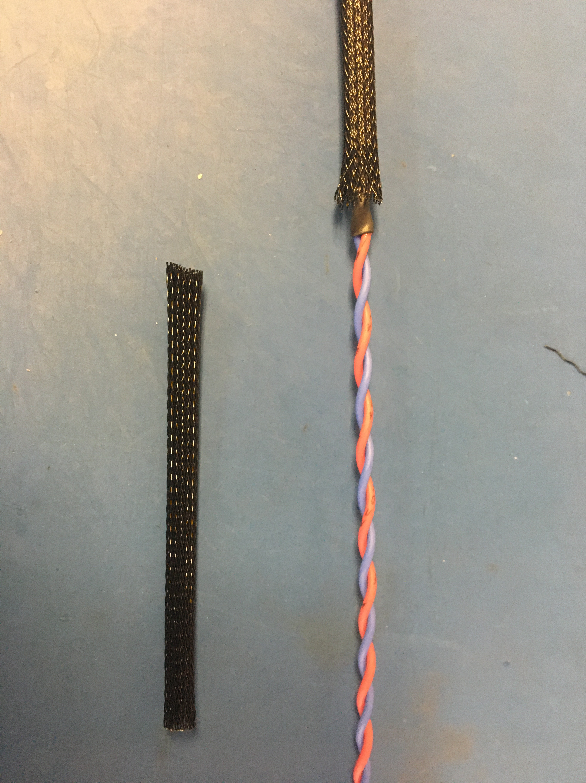
On the other end of the harness, cut the excess plastic braid. Again, the proper length is such that the plastic braid end in the middle of the metal braid joint.
Shrink tube
End of plastic braid

Slide 20
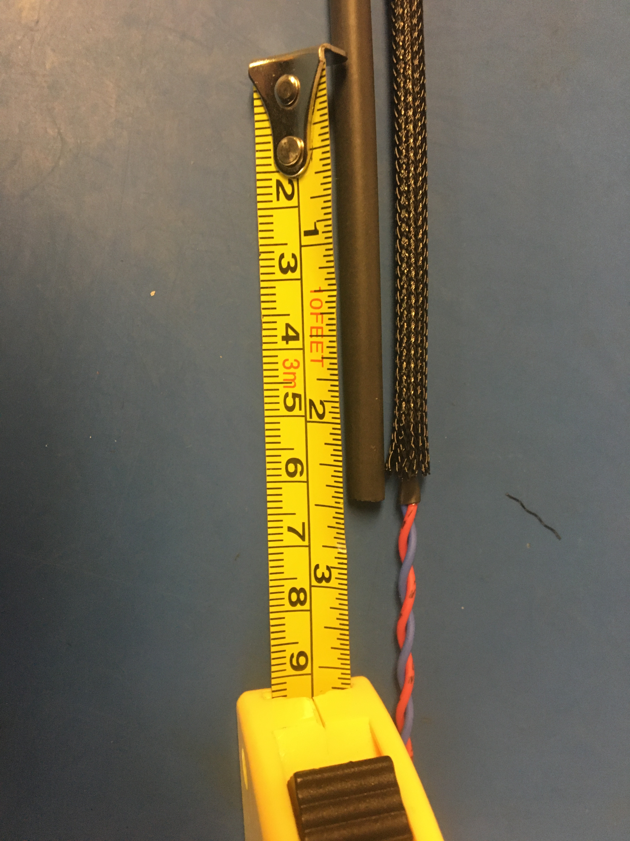
Measure out and cut ½ inch of 4.8 mm adhesive shrink tube. Slide the piece of shrink tube onto the twisted pair and down onto the plastic braid joint. Again, the plastic braid should be in the middle of the shrink tube piece. Apply, the heat gun to shrink the tube.

Slide 21
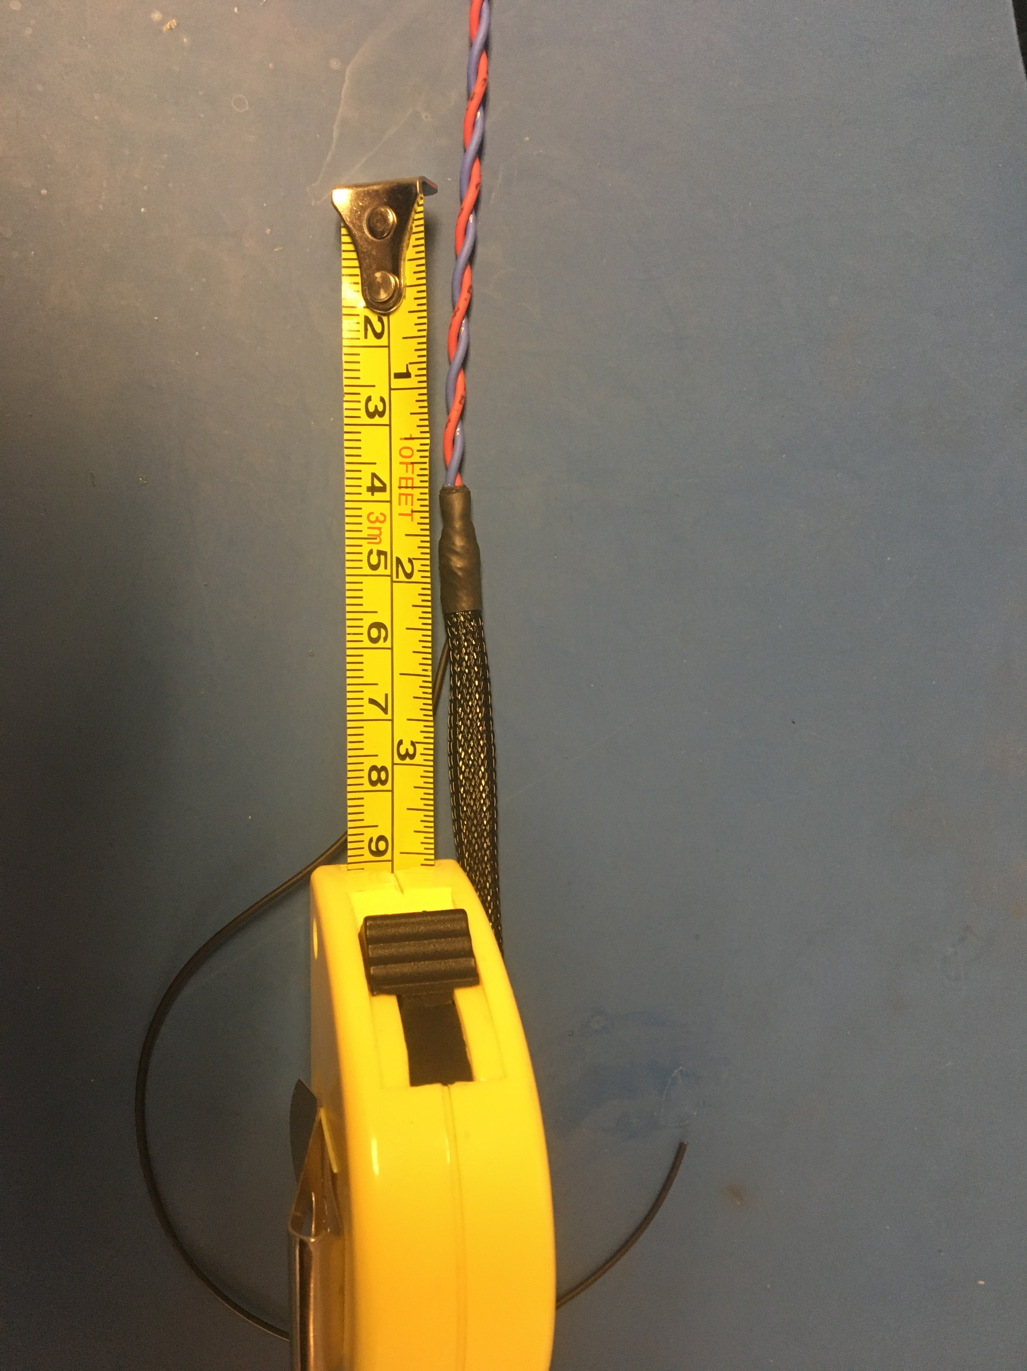
Trim both ends of twisted so that 1 ½ inch of the twisted pair coming out of the shrink tube joints.

Slide 22
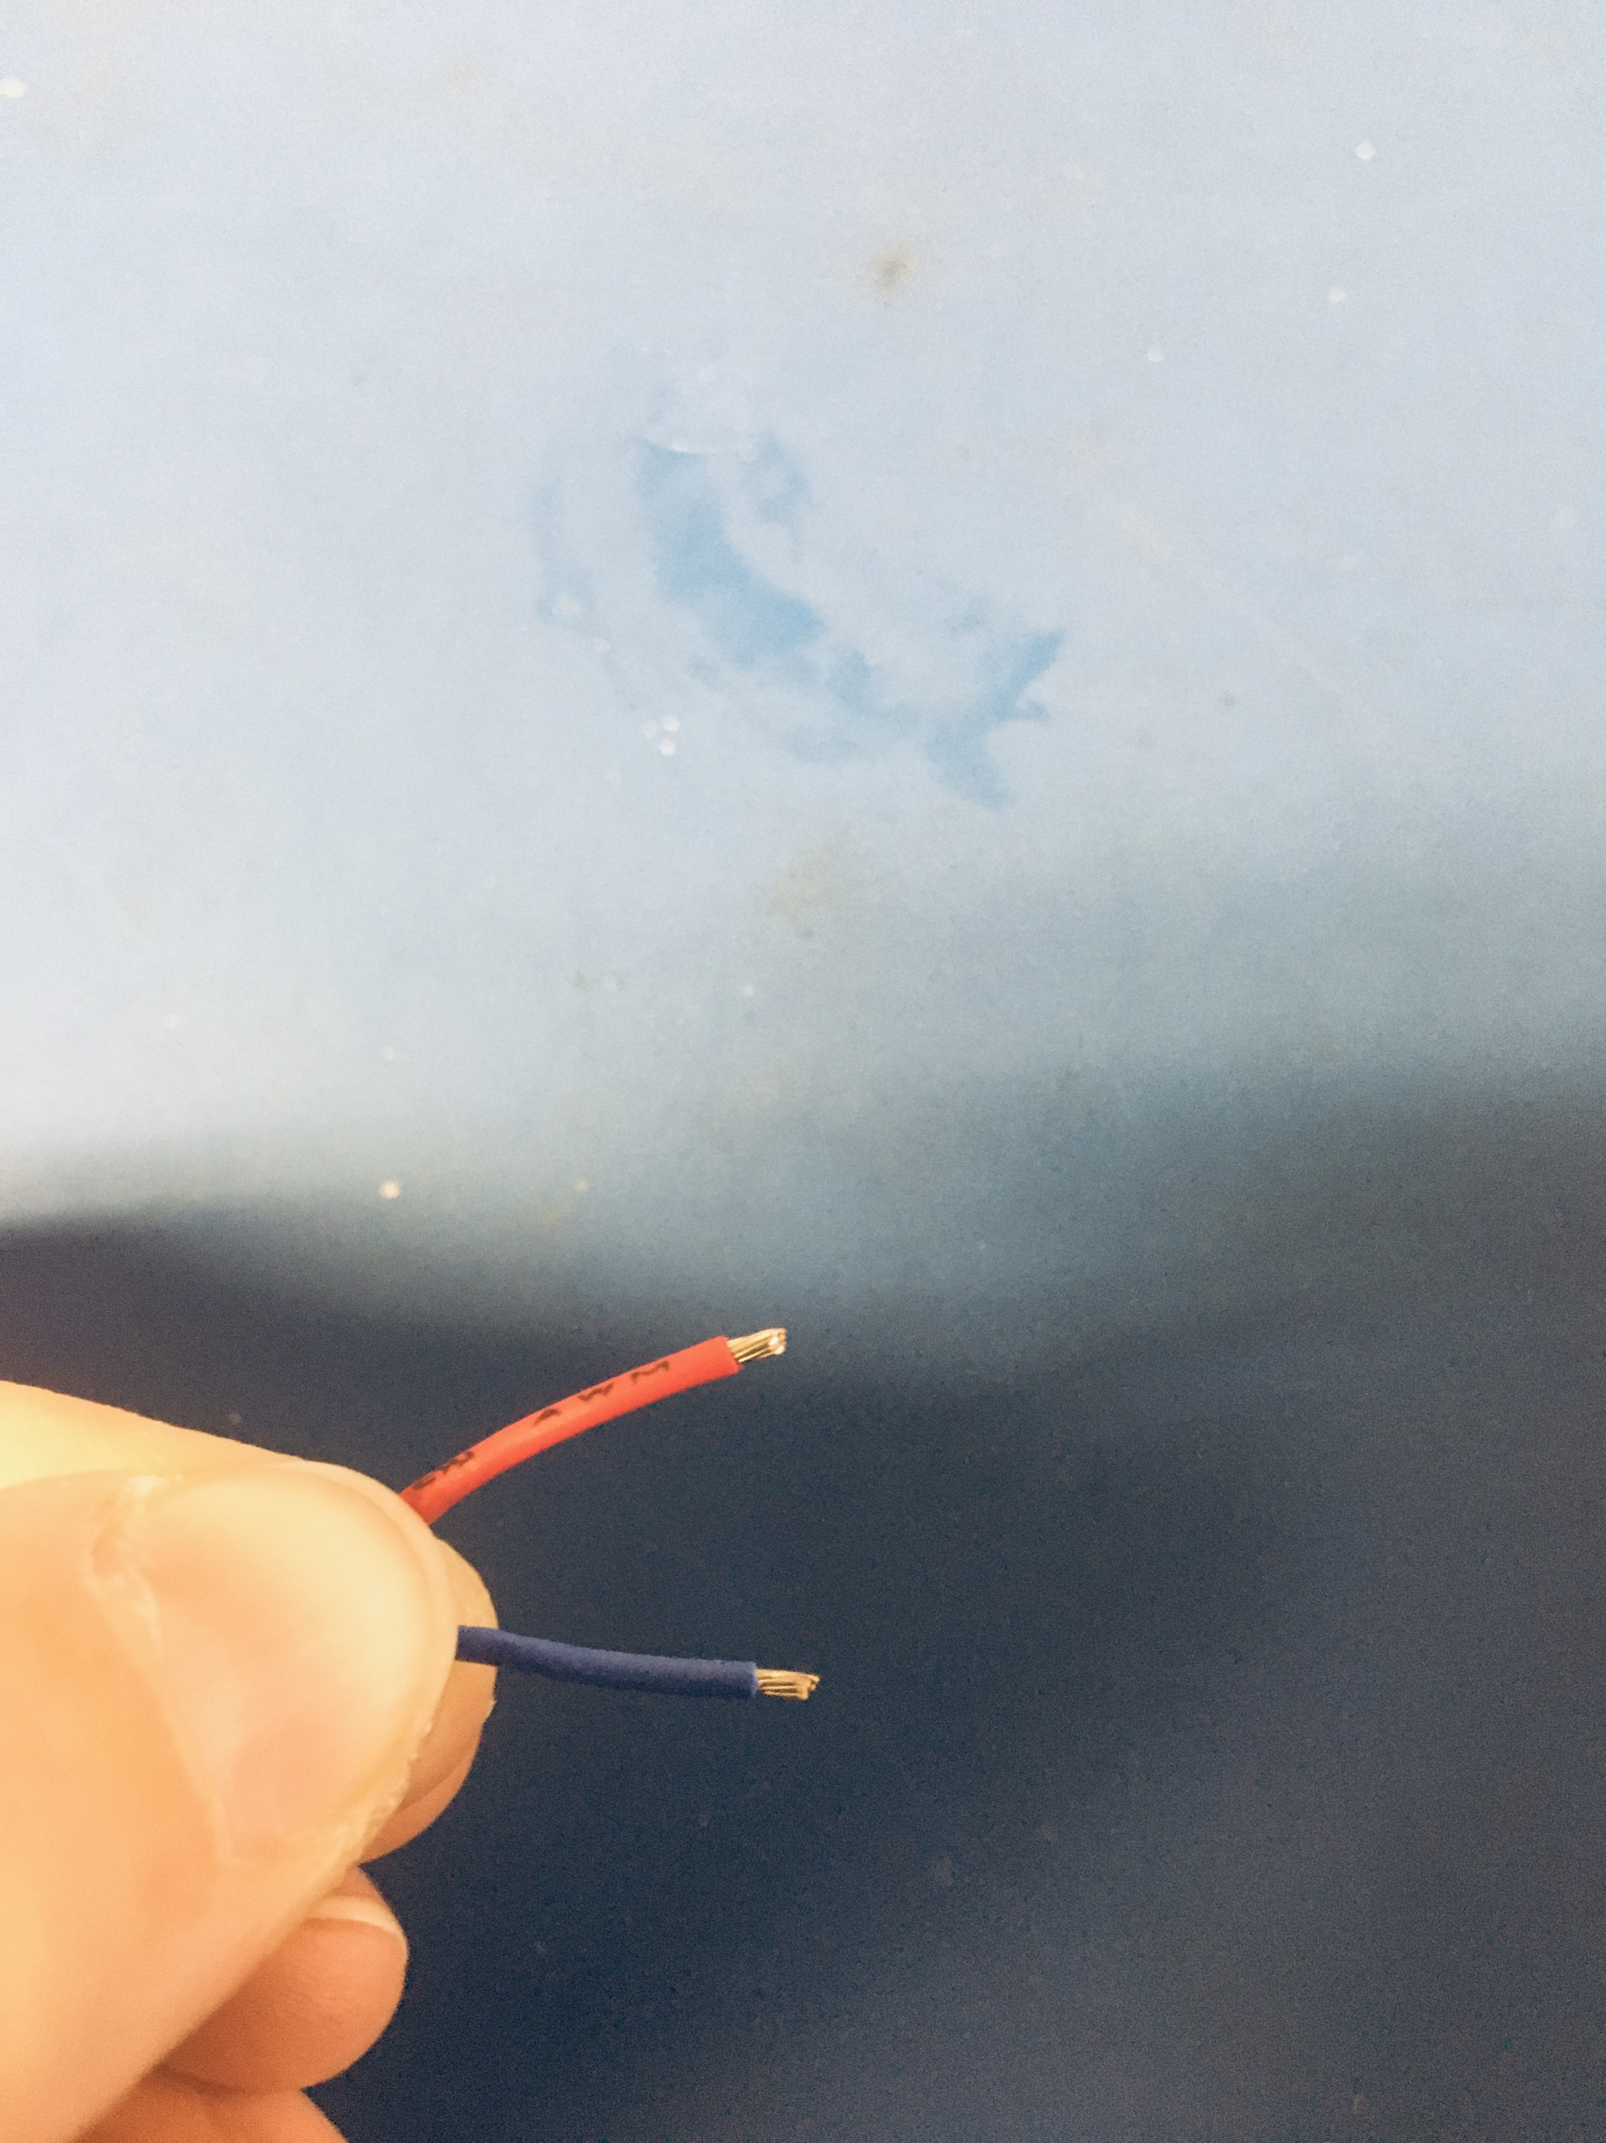
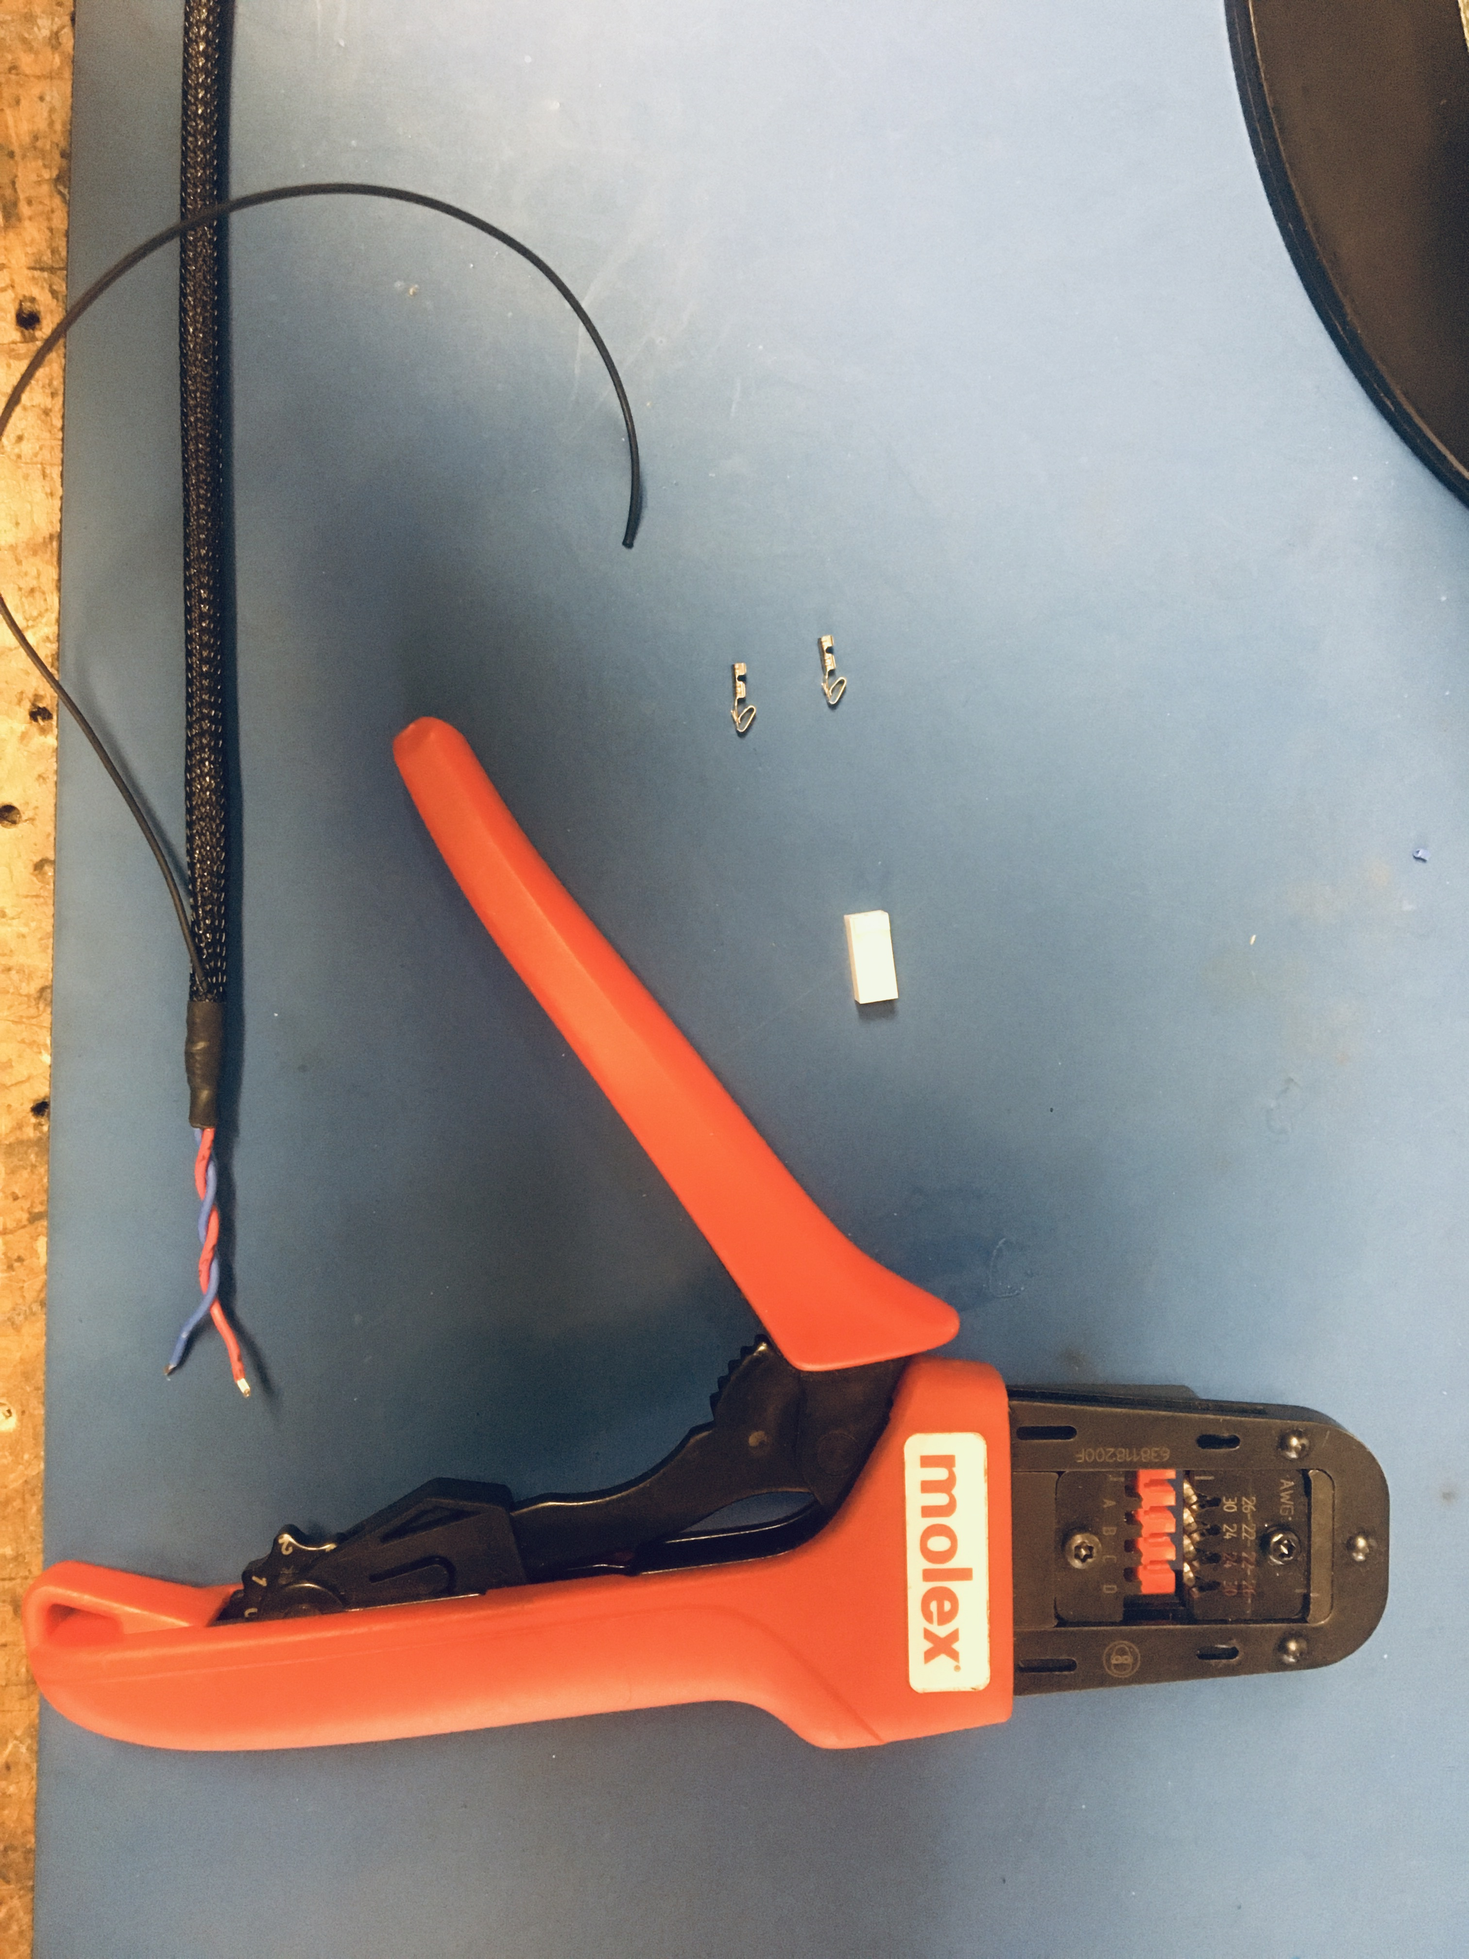
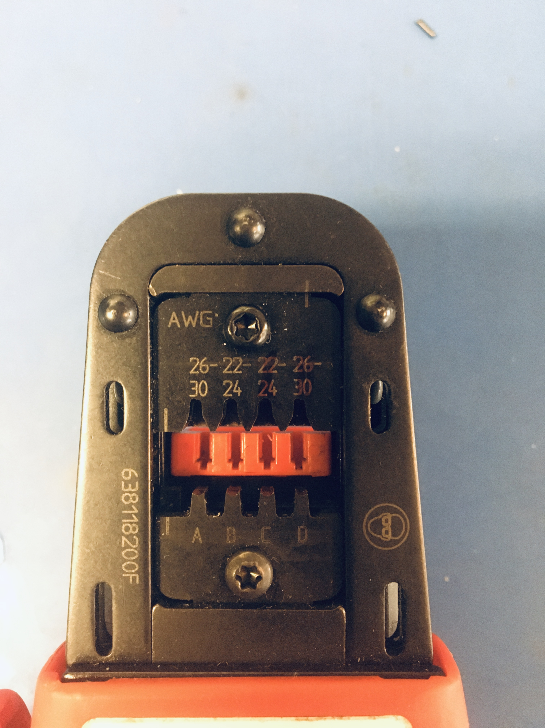
Strip the red and blue wire ends on the ground wire end of the harness. Be sure to strip only a little bit so there is about 2mm wire exposed. Using the KK 254 crimper, crimp on KK 254 tips onto the blue and red wires. Despite markings indicating otherwise, to crimp on the tips, use slots B (22-24).

Slide 23
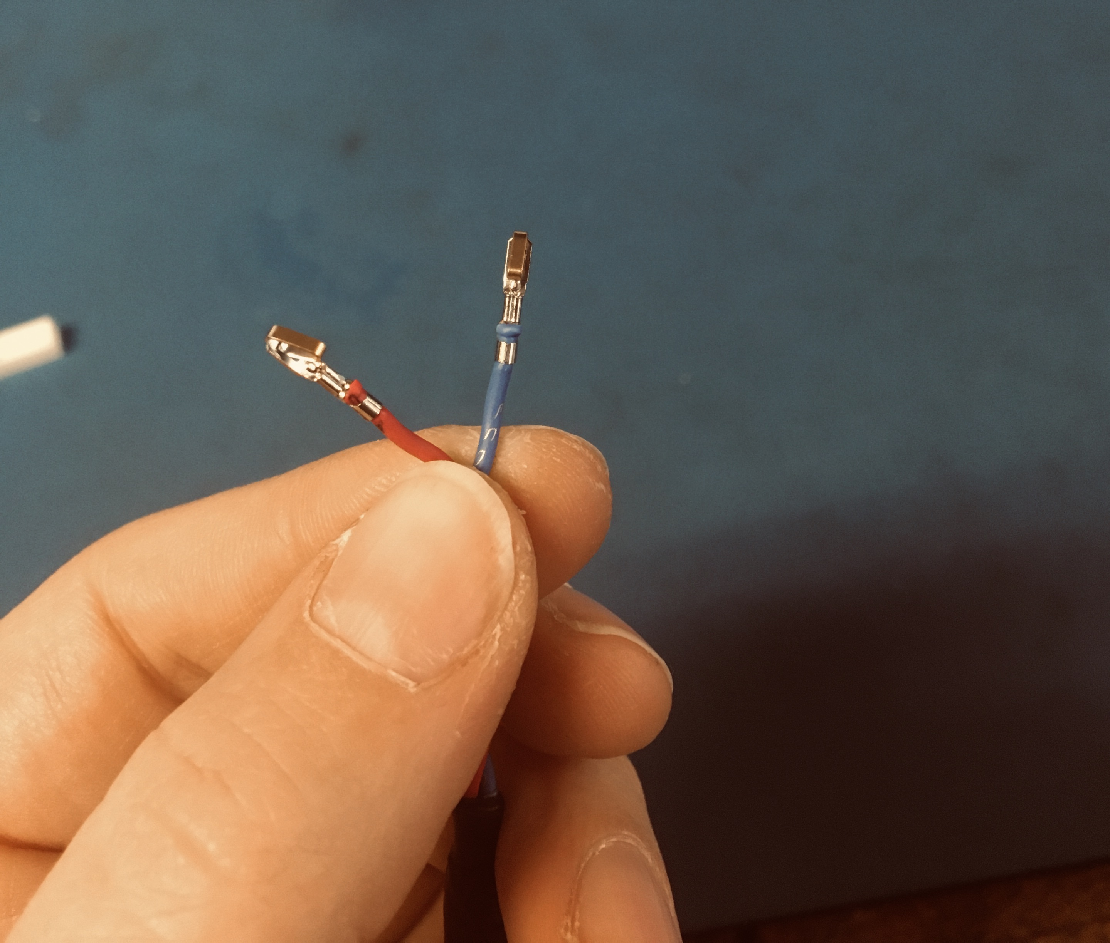
Once the wire ends are crimped, they should look as shown: exposed wires just poking out of the top and the isolation being out the bottom of the upper vise.
Wires just poking out
Isolation still in place

Slide 24
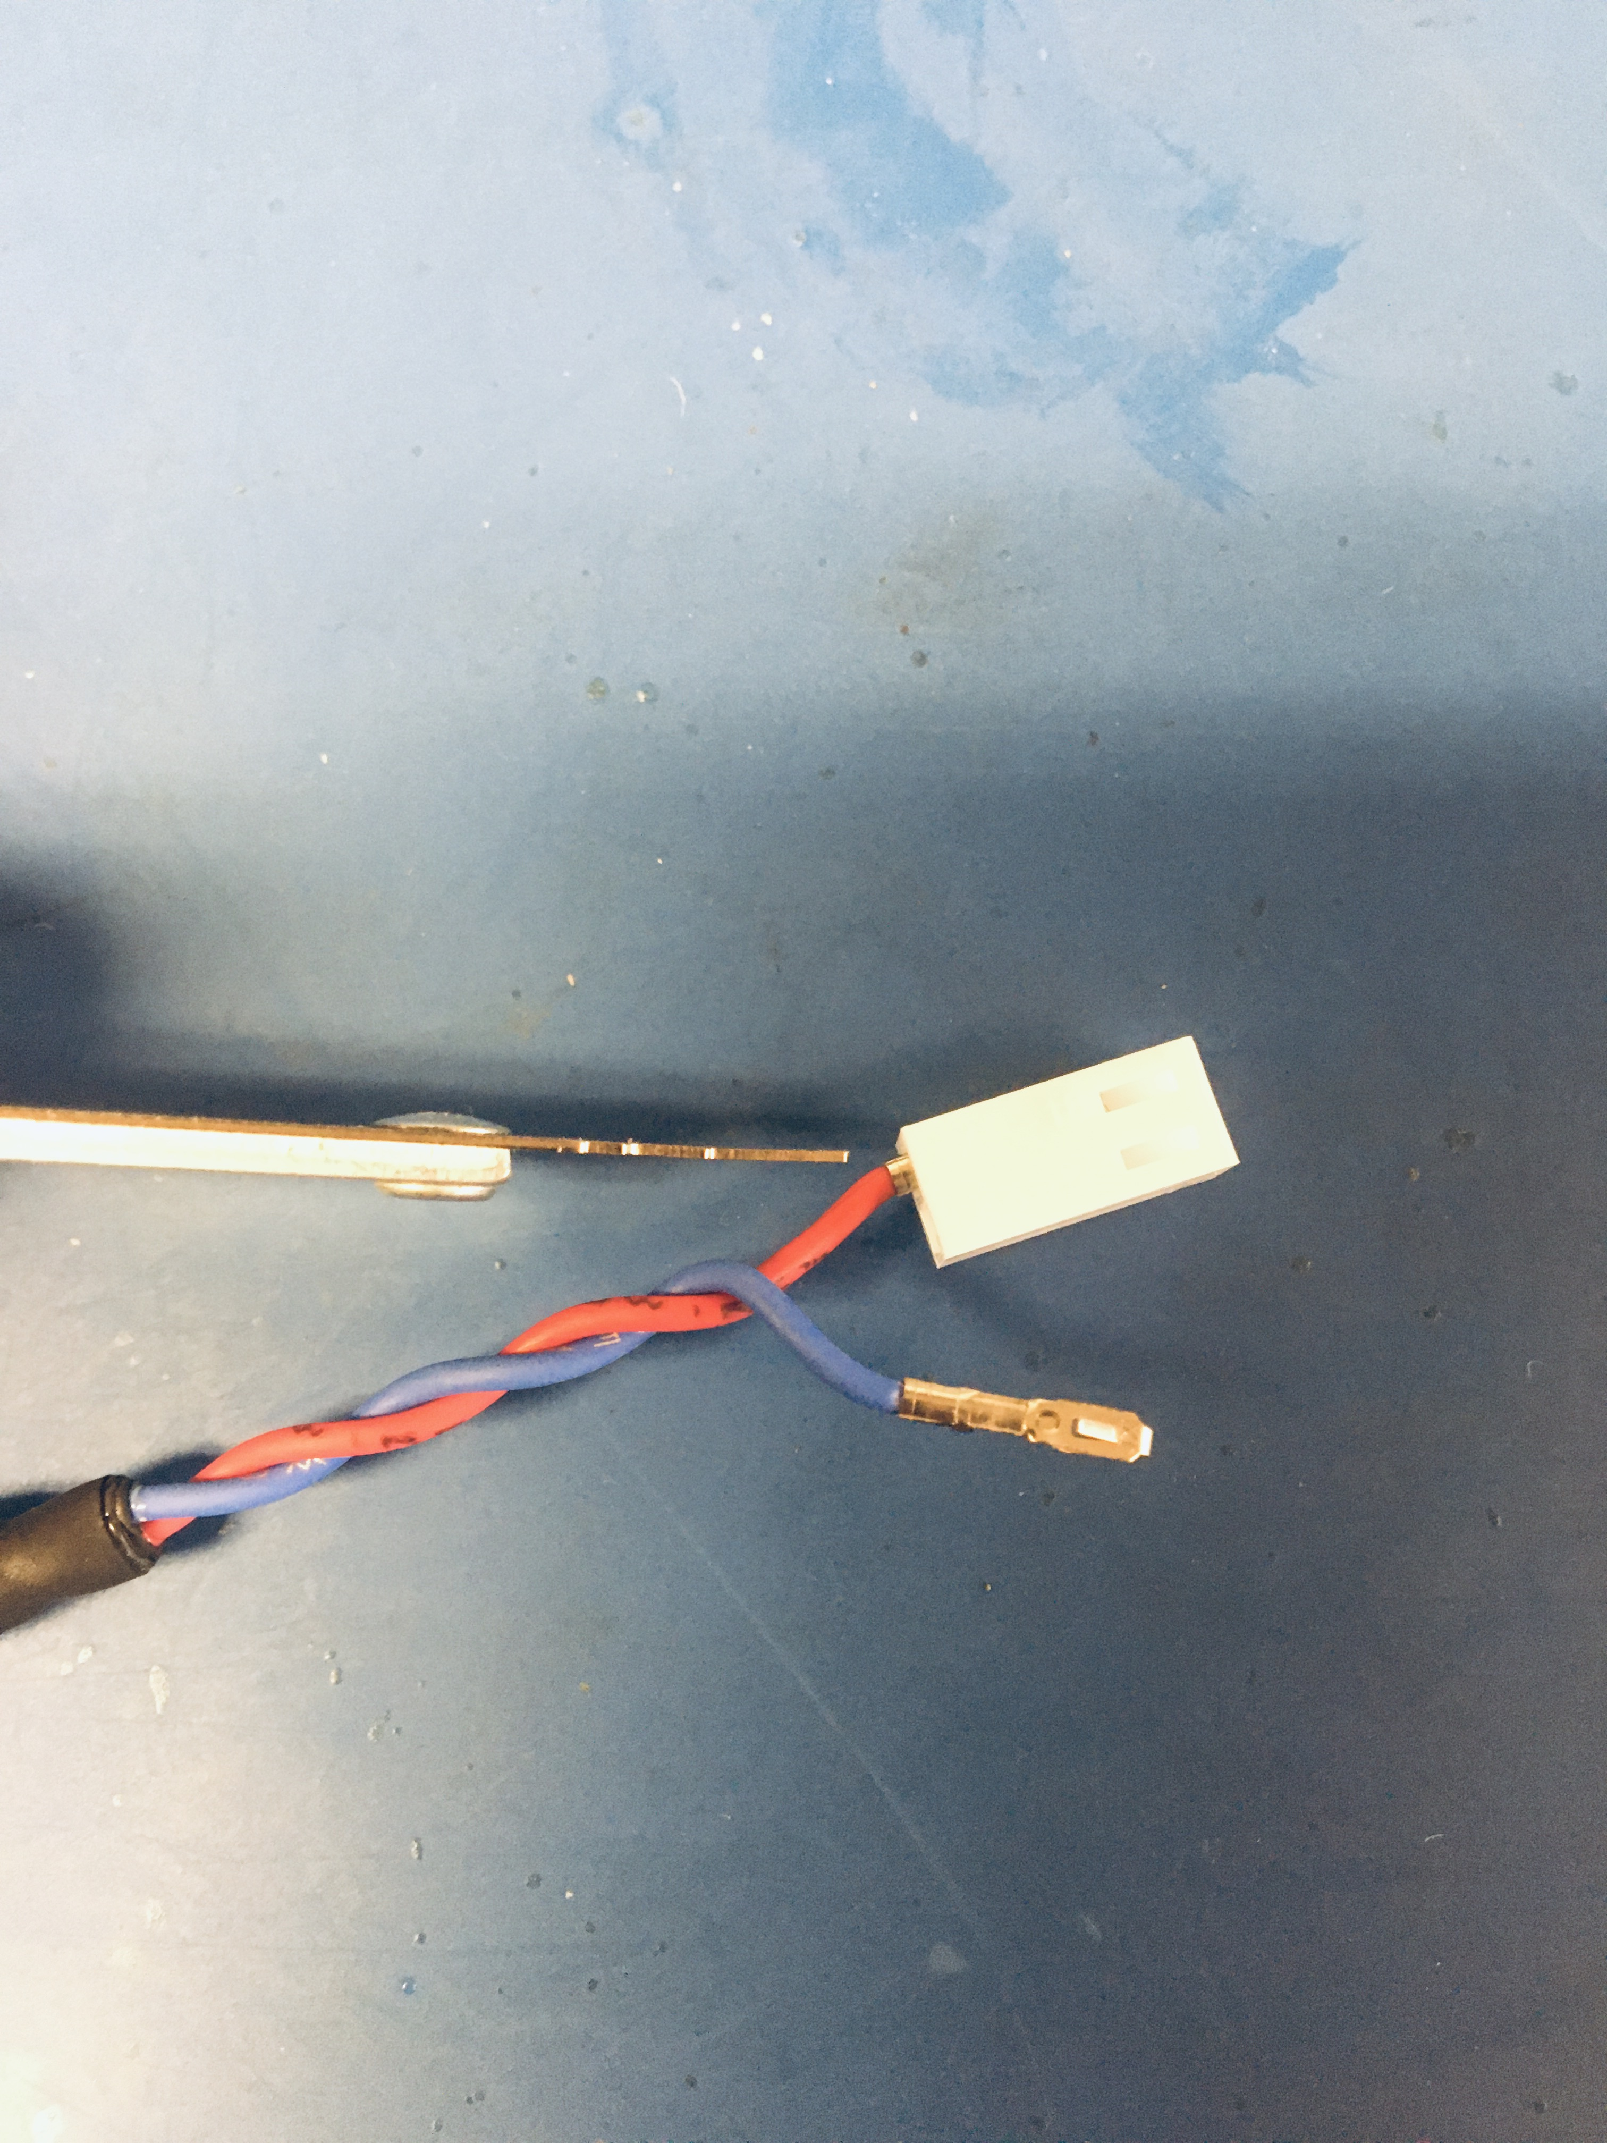
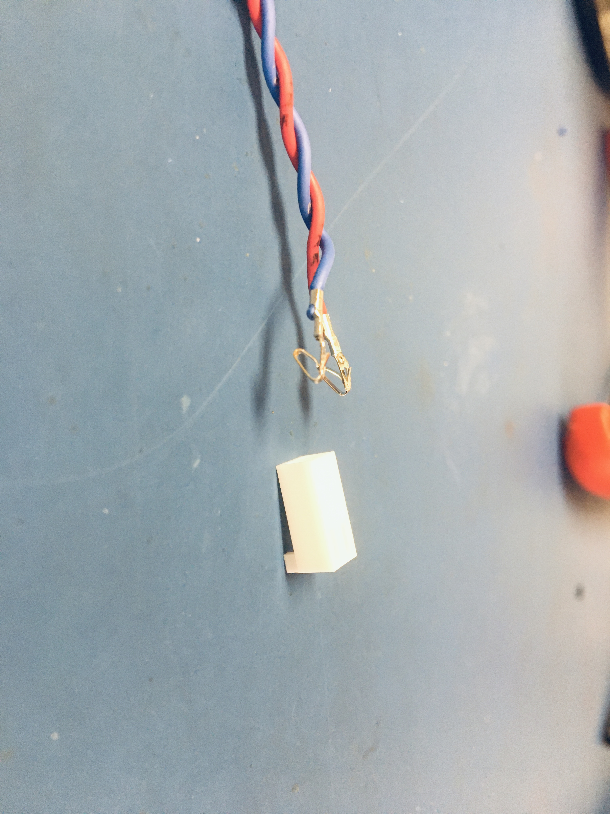
Insert the KK 254 tips into the KK 254 2 hole connector. Have the extrusions of both the connector and tips face down. Then push the tip into the hole of the connector until the tip clicks. If there are difficulties with pushing the wire tip in by hand, use the metal extraction tool to push on the bottom edge of the tip until it clicks in place. Red wire goes in the left hole and blue on the right.
Tip and connector extrusions turned toward table

Slide 25
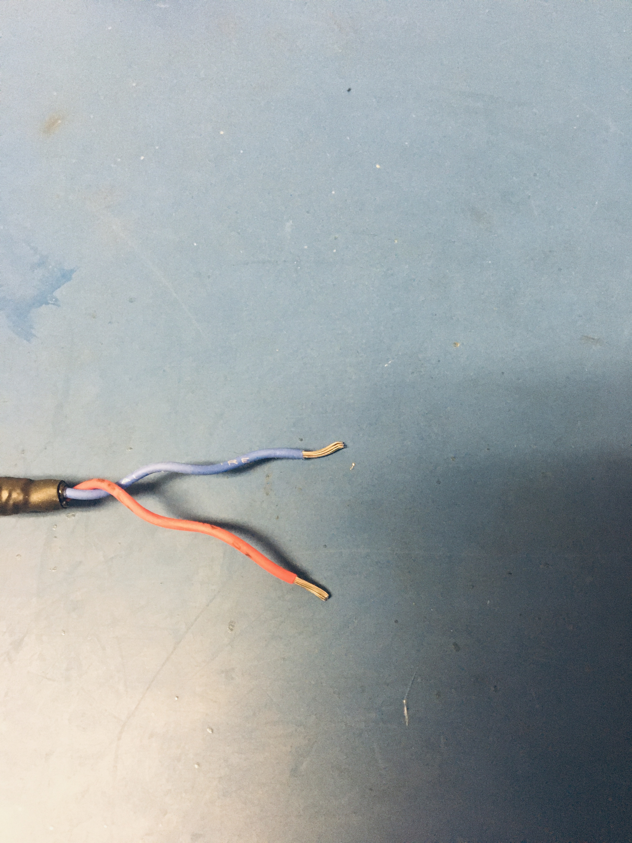
Strip the wires on the other end. The wires will need to have much more of the isolation removed than on the other end as the exposed wire need to go through the cylinder of the fork tip. Hence, there needs to be about 8-9mm of exposed wire. The ends of the wire will be just expose out of the top and the bottom of the fork tip for later soldering.

Slide 26
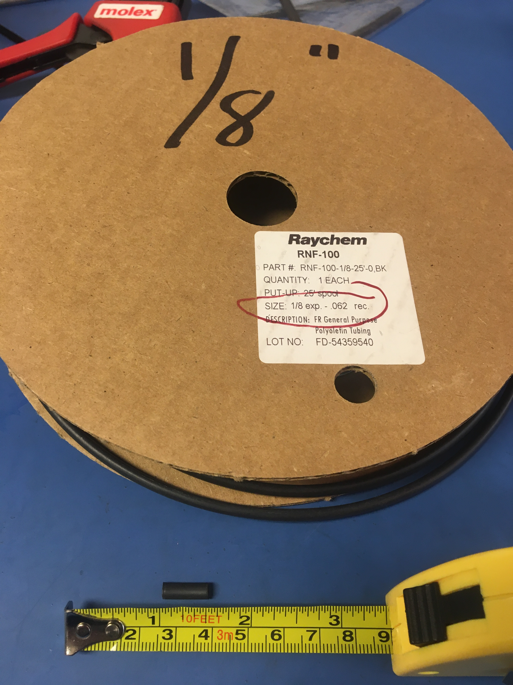
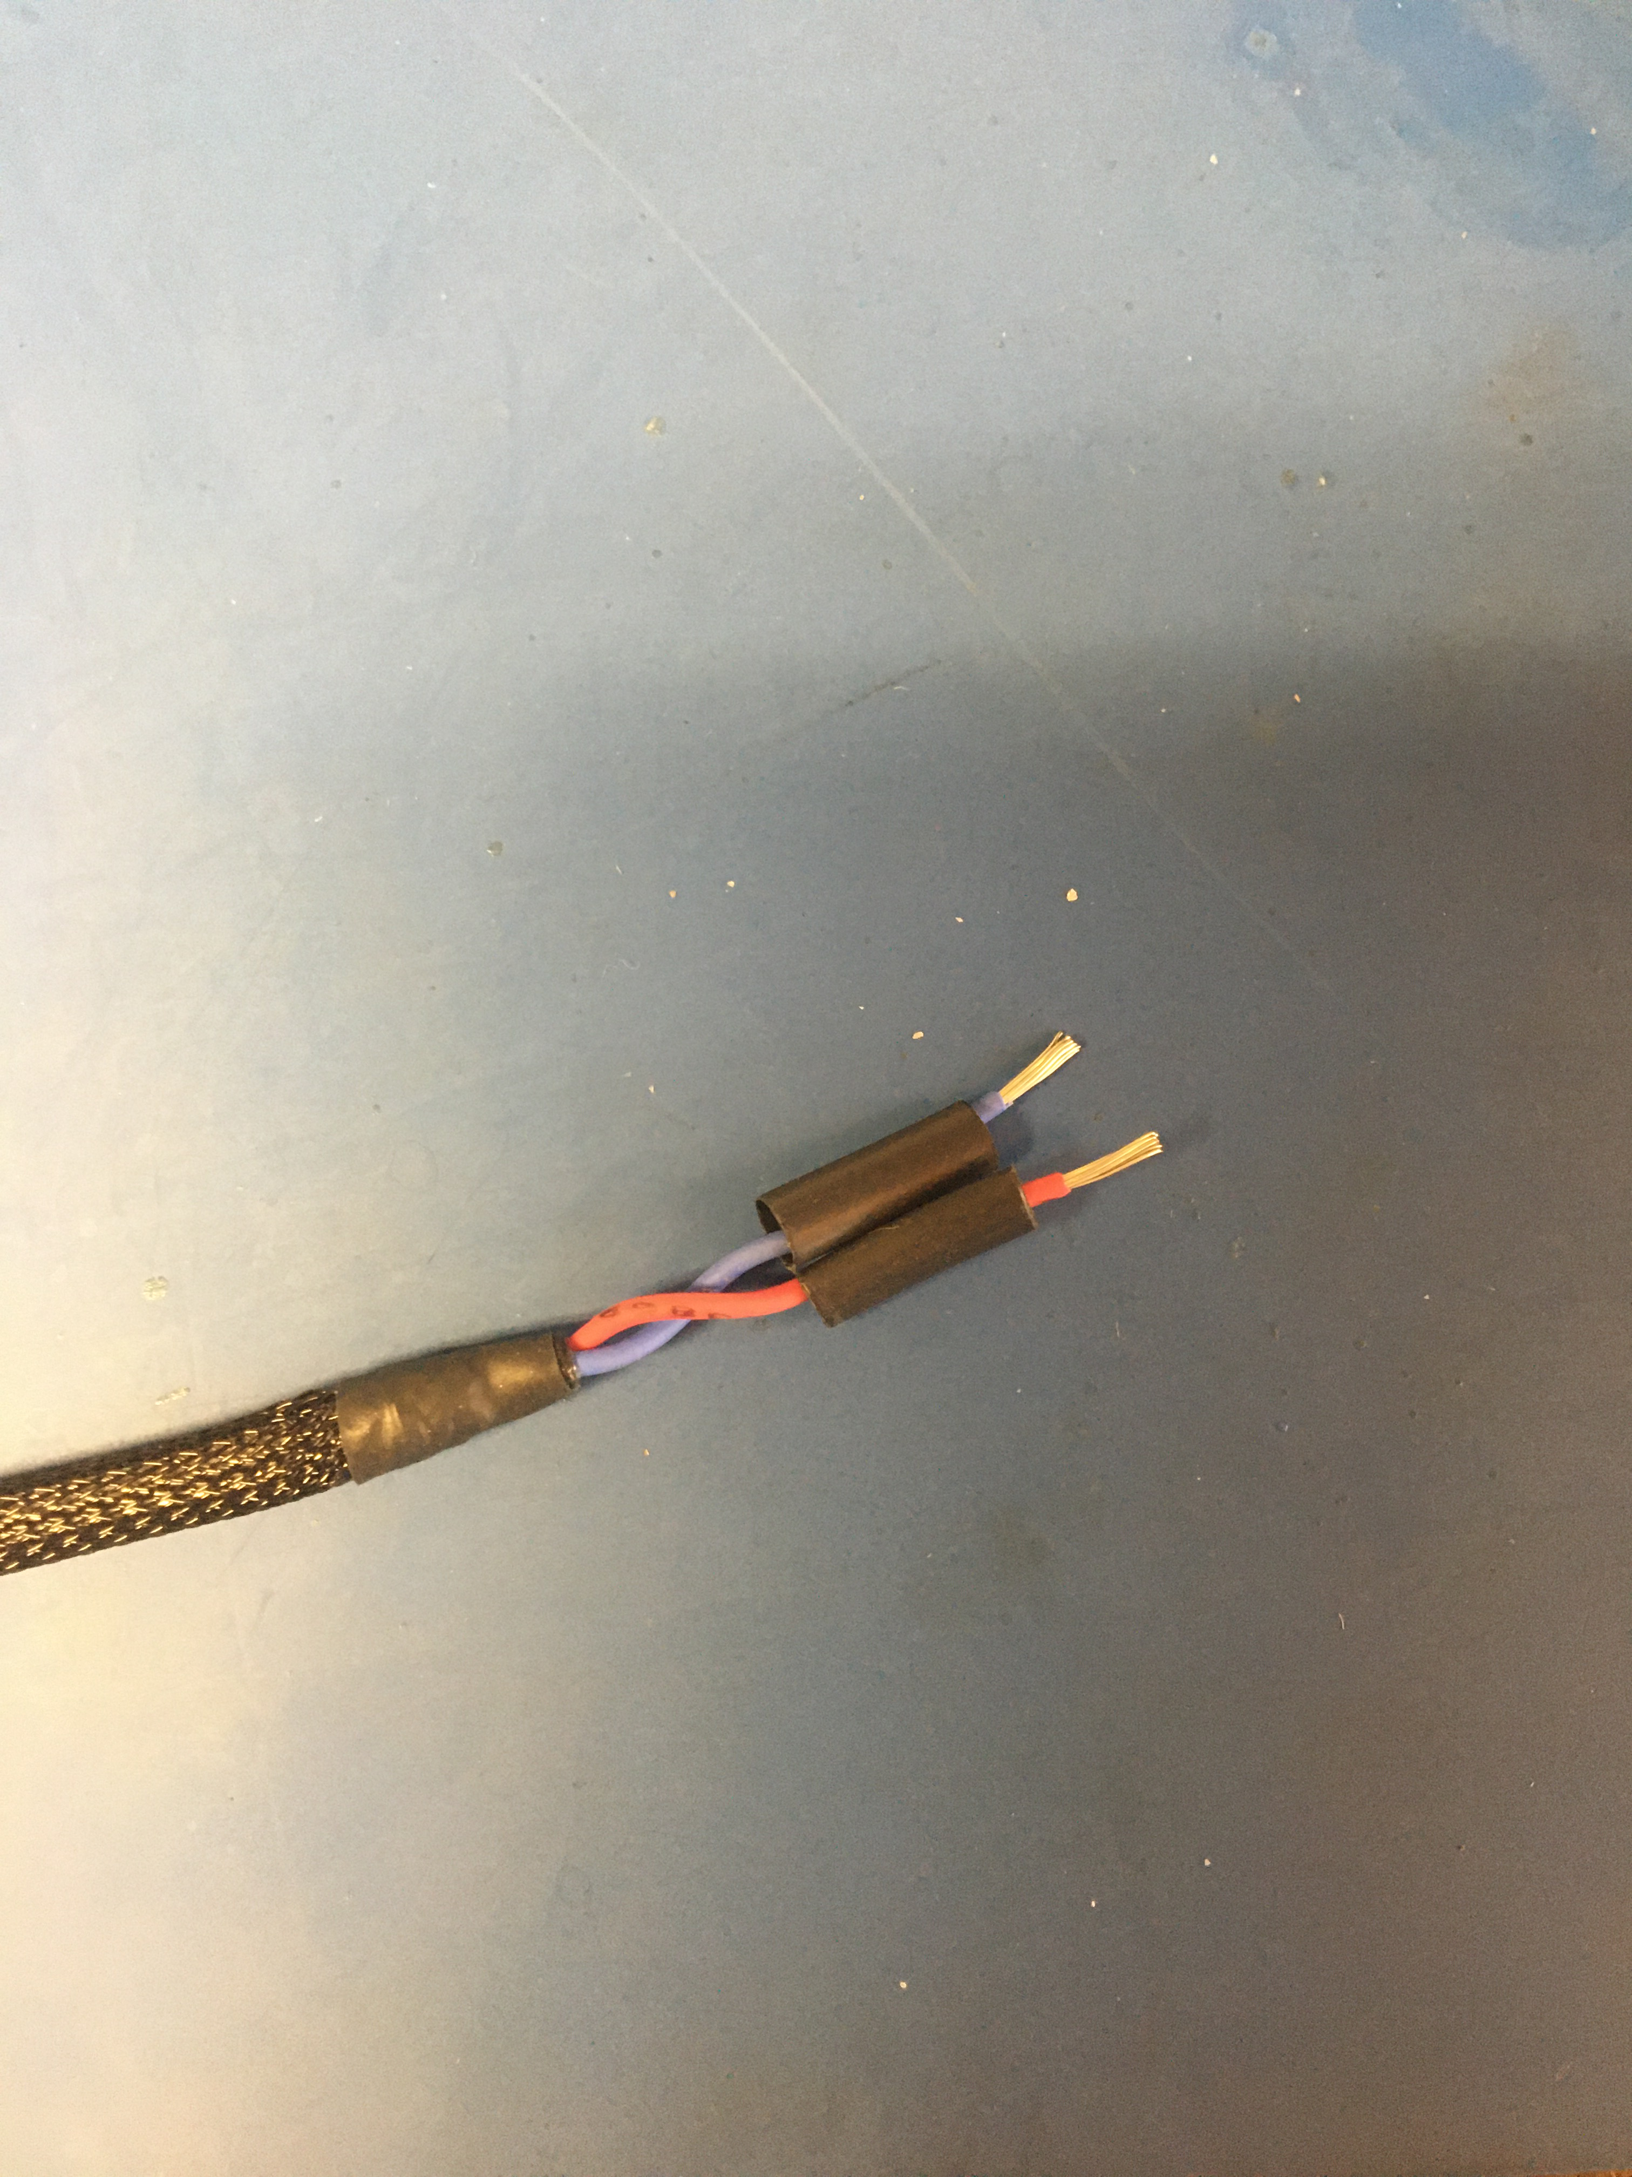
Measure and cut two lengths of 1/8th (non-adhesive) shrink tube that are ½ inch long. Place the pieces of shrink tube on the ends of the stripped wires.

Slide 27
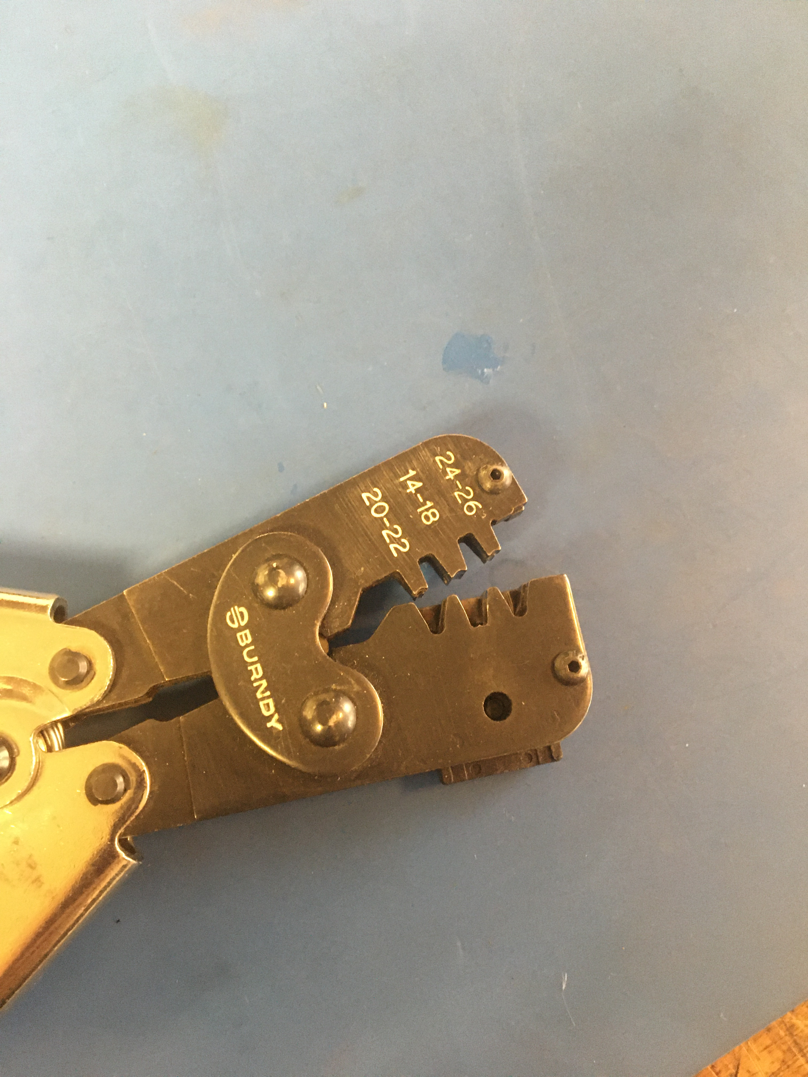
Using the fork crimper, crimp the fork tips onto the stripped red and blue wires. Make sure you keep the shrink tube on the wires as they will be used to over the crimped joint later.

Slide 28
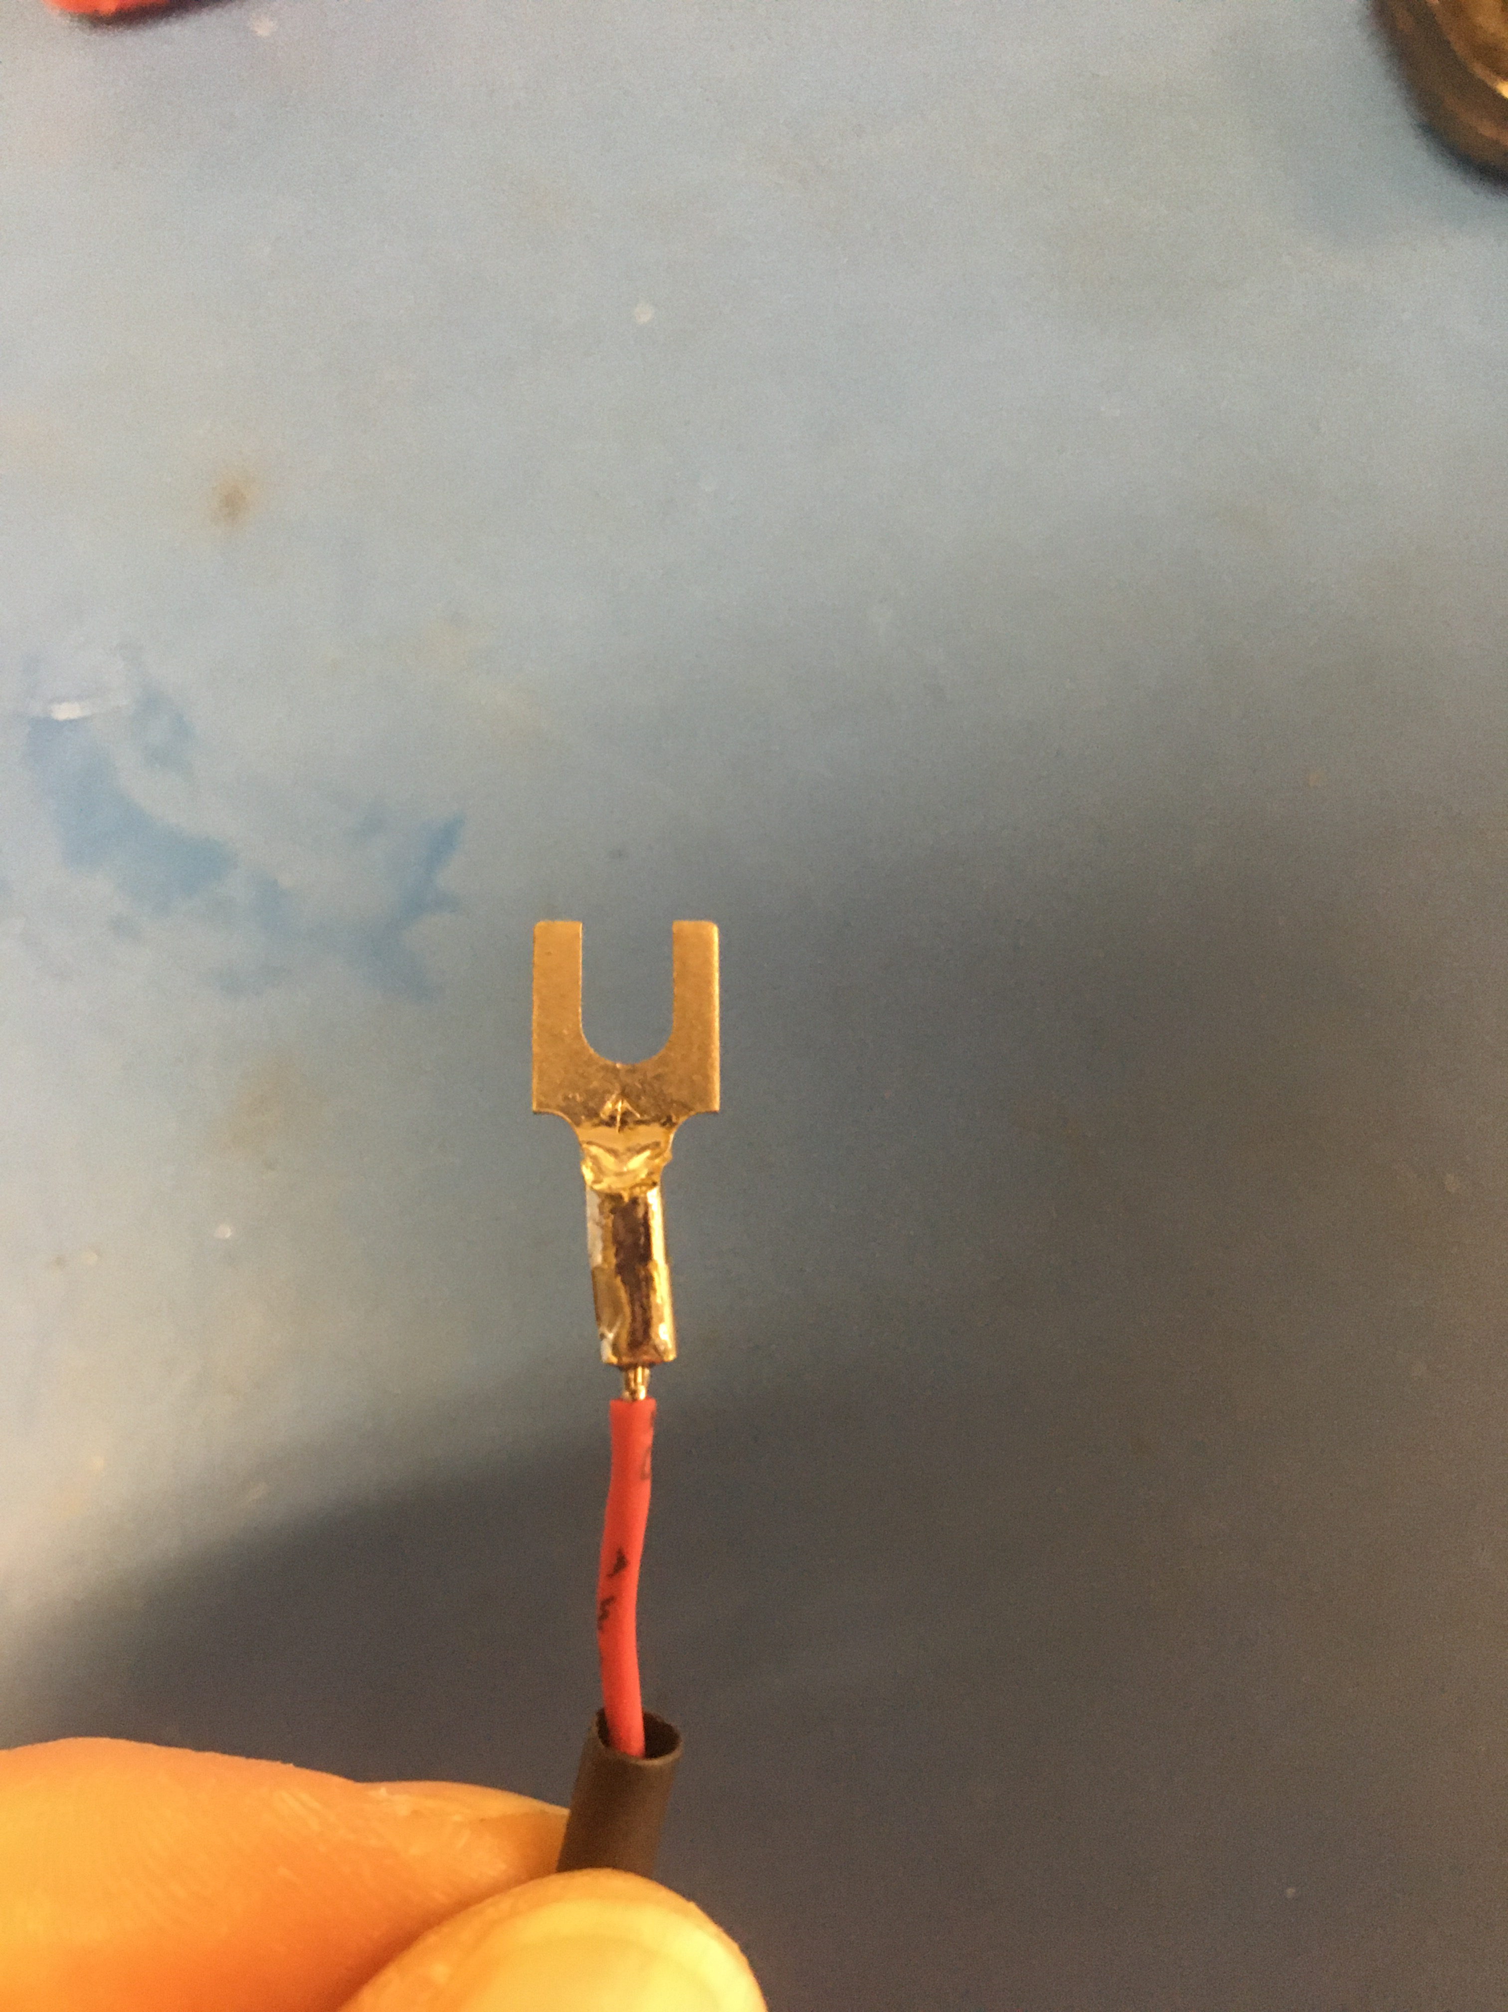
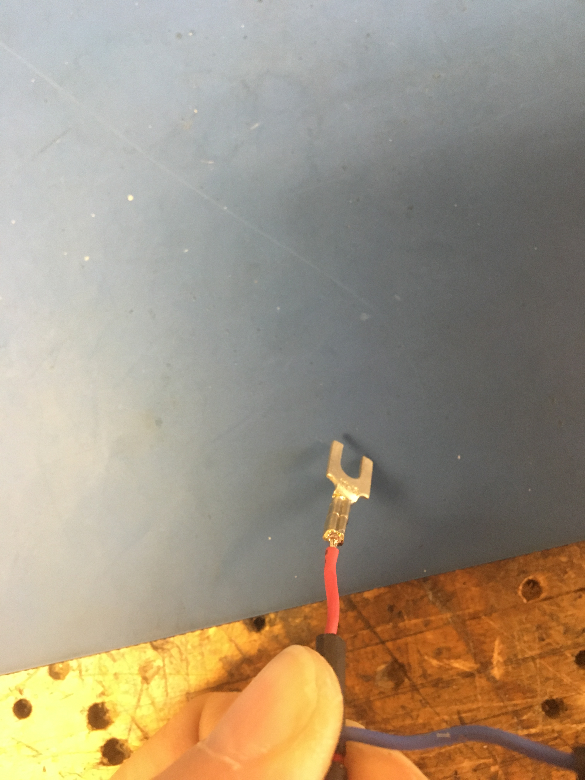
Solder the top and bottom of each fork tip where the stripped wire is minutely exposed. Be sure to be fast so the rest of the wire doesn’t heat up too much and cause the shrink tube to shrink.
Solder points

Slide 29
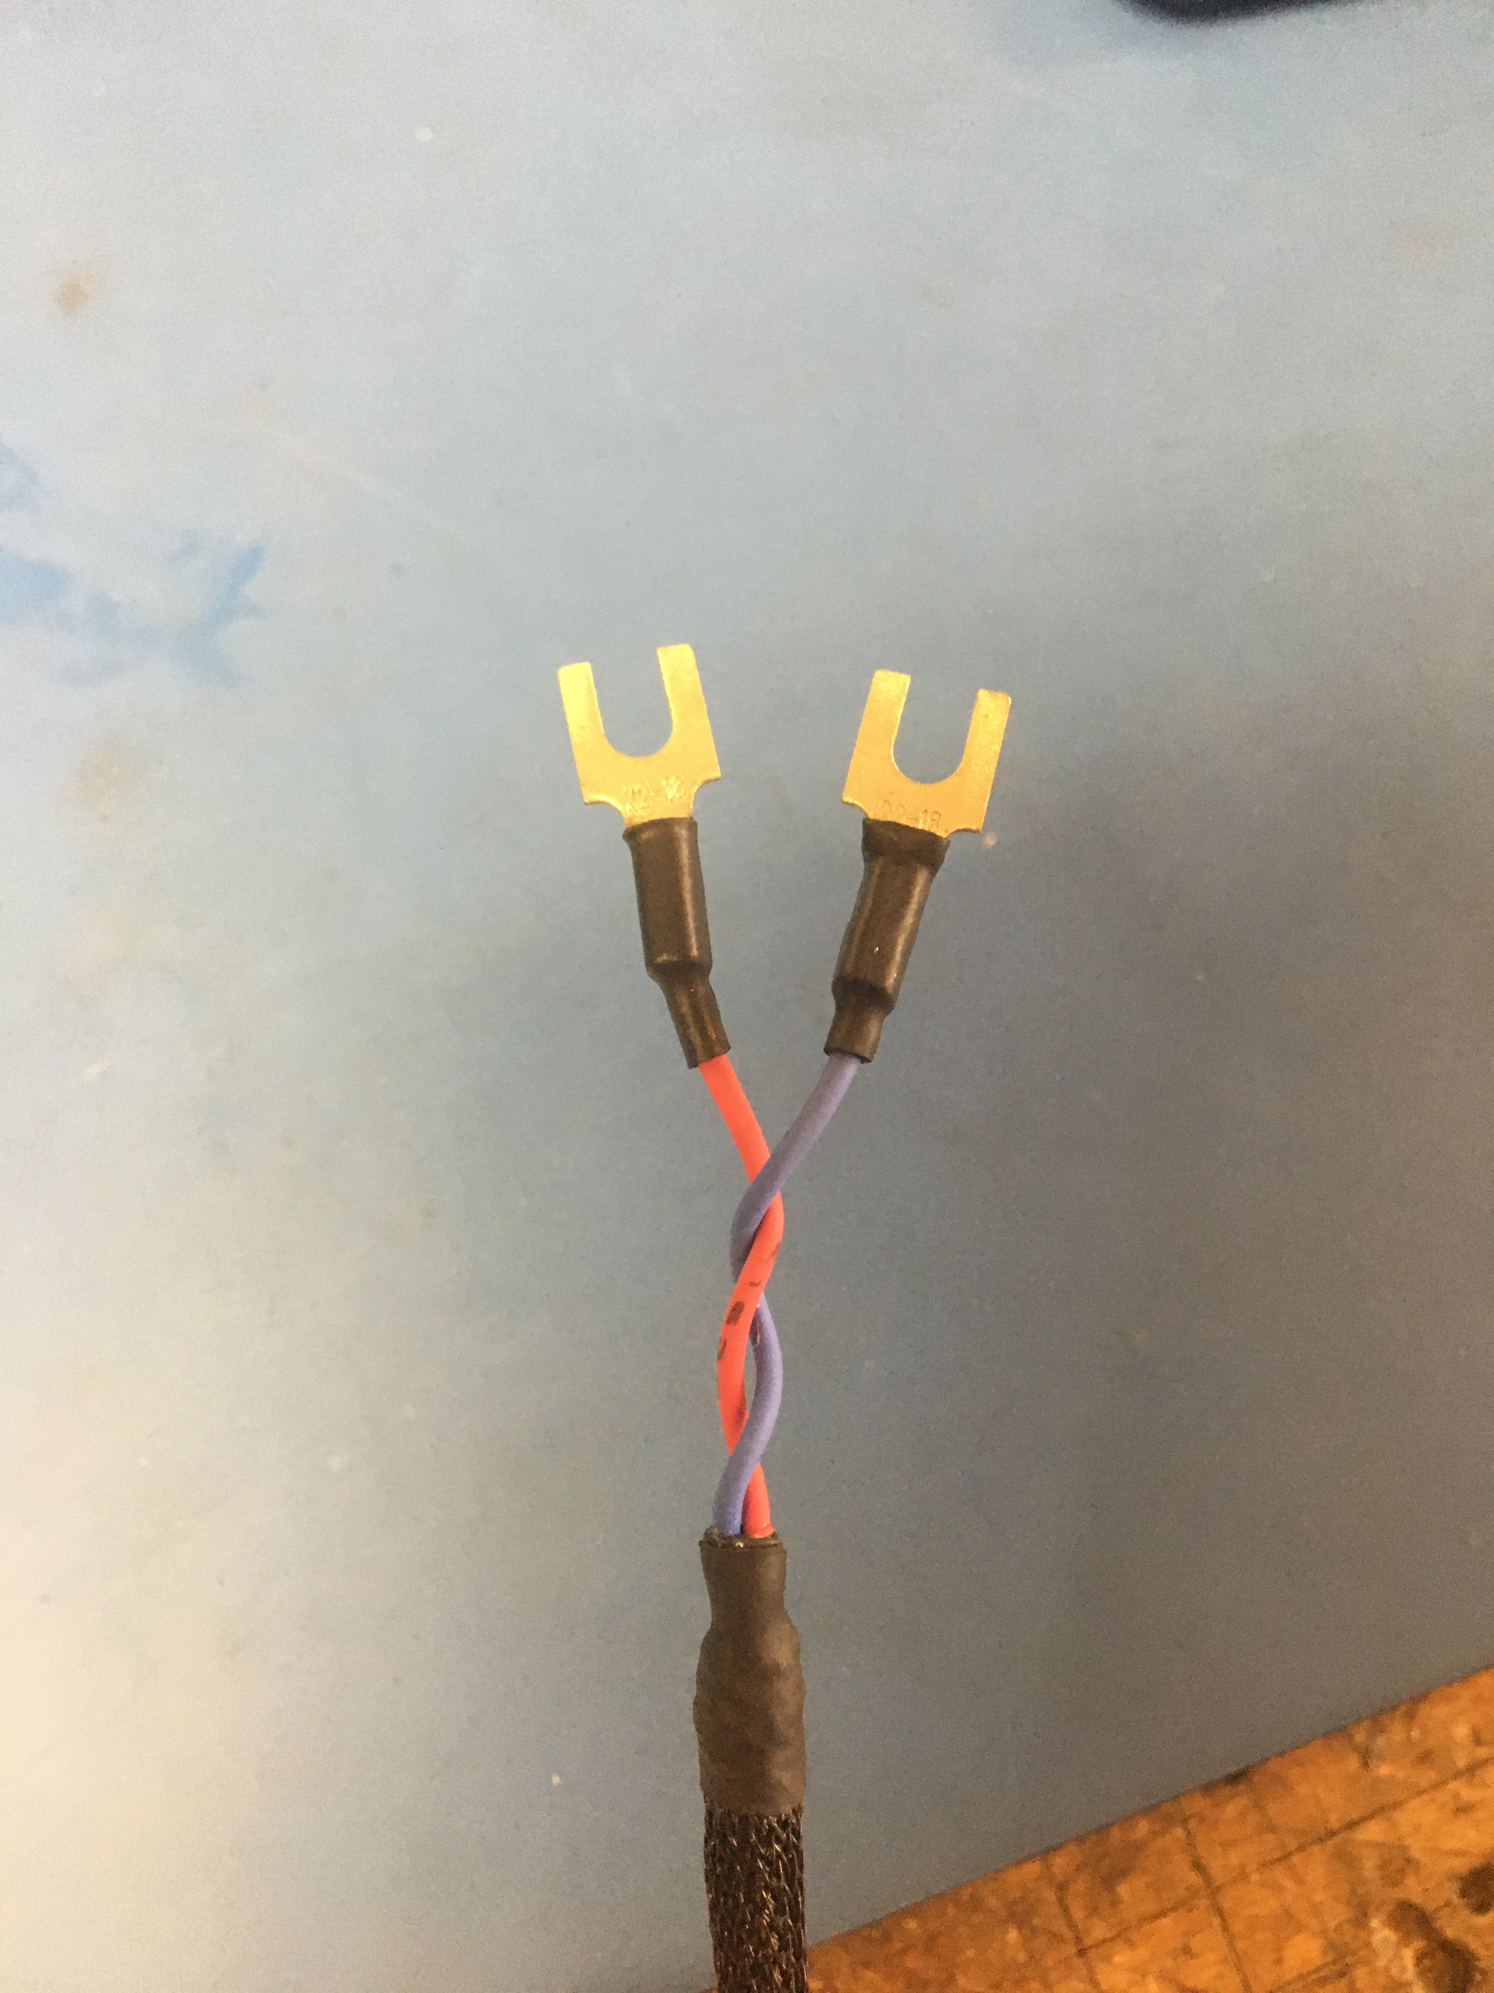
Slide the shrink tube that’s still on the wires over the crimp and solder joints and apply the heat gun.

Slide 30
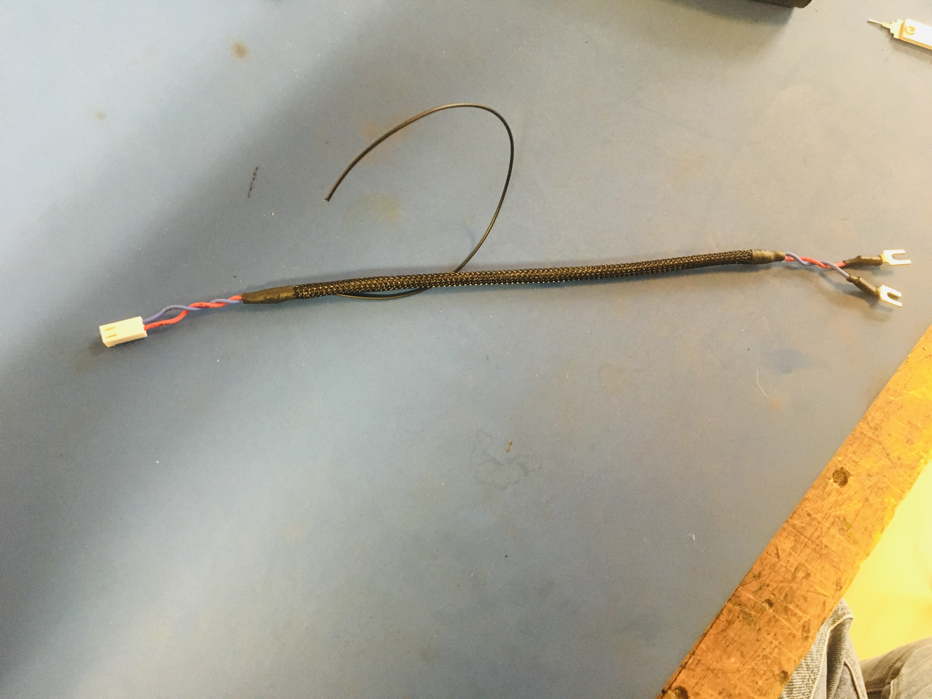
Wire harness complete! While the ground wire still needs an eye tip, it will be put on later when the harness is installed in a feed. That way the ground wire can be measured more accurately and cut to the appropriate length.

